Slide 1

Soil quality indictors in Life Cycle Assessment
Sandra Eady and Tim Grant
8 and 9 April 2014
CSIRO Sustainable Agriculture Flagship

Slide 2
Setting the scene
What is an LCA
Why undertake LCAs
Life cycle inventory activities to date in Australia

Slide 3
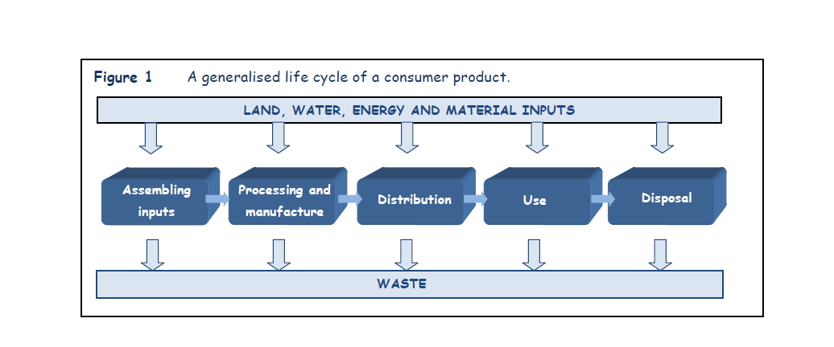
What is a Life Cycle Assessment?
LCA is the most commonly used tool to determine the environmental impact that a product or service has, by taking into account all of the impacts from resource extraction, production, use, through to end of life disposal.
Source: Ryan, S 2012. Buying Choices for a More Sustainable Canberra, Report for the ACT Commissioner for Sustainability and the Environment

Slide 4
Interaction between the economy and environment
Economy /
Technosphere
Realm of human
activity
“Flows” associated with soil degradation
Source: RMIT LCA Course Notes
4

Slide 5
Human Health
Ecosystem Health
Social
Equity
End points
Respiratory
diseases
Extinction
of species
Reduced
resource
base
Seawater
level
Dying
forests
cancer
Mid-point indicators (links in the cause-effect chain)
Ozone layer
Acidification
Nutriphication
Radiation
Carcinogen
Land-use
Ecotoxicity
Minerals
Fossil fuel
Smog
Climate
Environmental flows
Life cycle inventory of environmental flows – CO2 NOx Pb, land ect
Source: RMIT LCA Course Notes

Slide 6
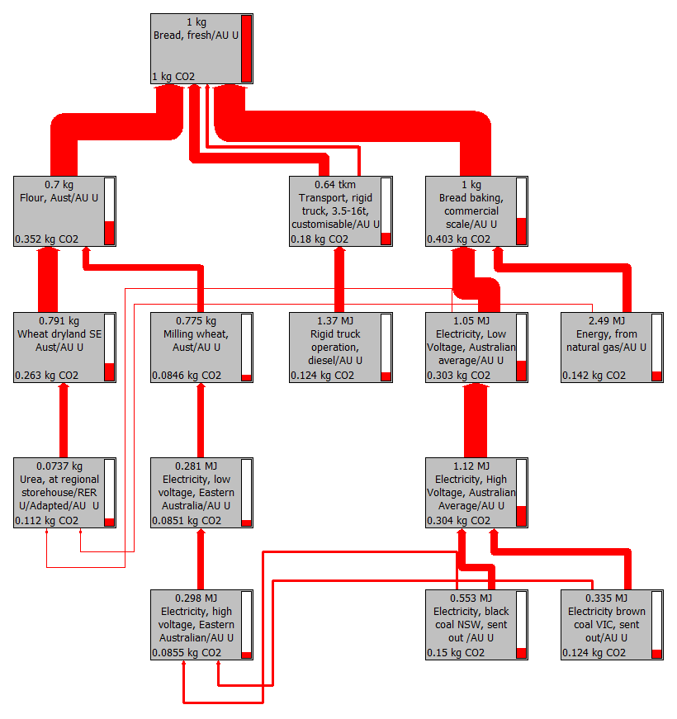

Slide 7
Reasons for environmental assessment
(Life Cycle Assessment)
Environmental product declarations to inform consumer choice
  European Commission to adopt LCA as the approach to be used for environmental assessment of products for the ‘Single Market for Green Products’ (see http://ec.europa.eu/environment/eussd/smgp/product_footprint.htm).
Delivery agreements where the supplier is required to demonstrate an on-going improvement program of environmental sustainability
    EU, Japanese, Australian markets – especially supermarkets
The likely advent of trade agreements premised on climate change mitigation efforts
      Covered economies versus uncovered economies for carbon pricing

Slide 8
Reasons for environmental assessment
(Life Cycle Assessment)
Unilateral need to respond to global warming – triggered by realignment of insurance risk and costs to the economy
        Covered economies versus uncovered economies for carbon pricing
Negotiations for international agreements on greenhouse gas emissions reduction targets
      Especially China and India for export production (carbon footprint of exports)
Need to produce more food globally with a lower environmental impact
        Global significance but more so for countries that produce large amounts of staple foods – e.g. Australia, China, India, Africa, south America, north America, Russia……
Need to have a consistent framework for assessing the environmental impact of different industry sectors and combined impact in different regions
        Regional and national significance for evaluation of NRM investments, industry investment in sustainable production, ......

Slide 9
Role of Life Cycle Inventory
Life Cycle Assessment is only as good as the underlying data or Life Cycle Inventory (LCI) that is used for the analysis.
Country specific LCI for agricultural products is essential for Australian agriculture to undertake environmental impact studies.
In the absence of country specific data, LCA practioners will use the next best data available and this is often from Europe and the USA (with ecoinvent® being the most used LCI).

Slide 10
Advantages of a Public Inventory
Act as a repository for LCI from the many LCA studies being undertaken, to reduce duplication of common inventory e.g. wheat
Consistent approach applied to inventory across sectors e.g. consistent modelling of pesticide flows
Guidelines and standards can be set for:
  Transparency
  Data quality
  Review
  Standard formats
Inventory can be structured so that it can be efficiently updated e.g. change in N₂O emissions factor for N fertiliser use, improved flows model as GIS data is updated nationally.

Slide 11
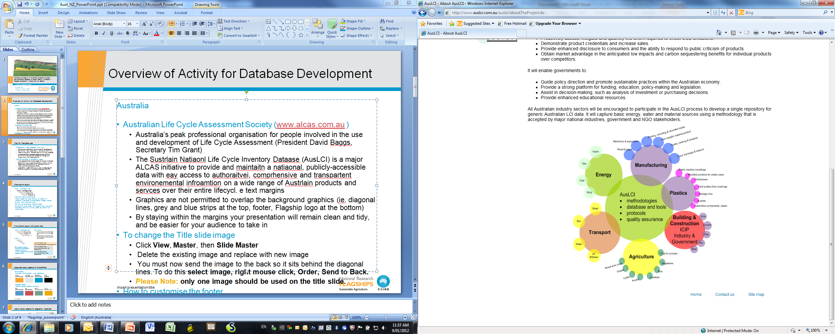
LCI Activities in Australia
Series of guideline documents on data collection, reviewing, best practice guide now available on AusLCI website
Major project by BPIC now completed with gate-to-gate data published, needs further development to be integrated into full life cycle unit process LCI.
AusAgLCI – commenced in Dec 2011, will cover major products, public research agency providing data, funding support from industry, goal is unit processes from cradle-to-farm gate.
Extensions to AusAgLCI – Department of Agriculture Innovation Fund project for grazing and general cropping inventory (CSIRO and LCS; March 2014) and GRDC project for detailed cropping systems including rotations (NSW DPI, CSIRO and LCS; July 2014)

Slide 12
Over to Tim........
Elementary flow, cause and effect pathways, impact assessment in general
Approaches taken for different land-based impact categories
How should we think about soil indicators in the context of LCA

Slide 13
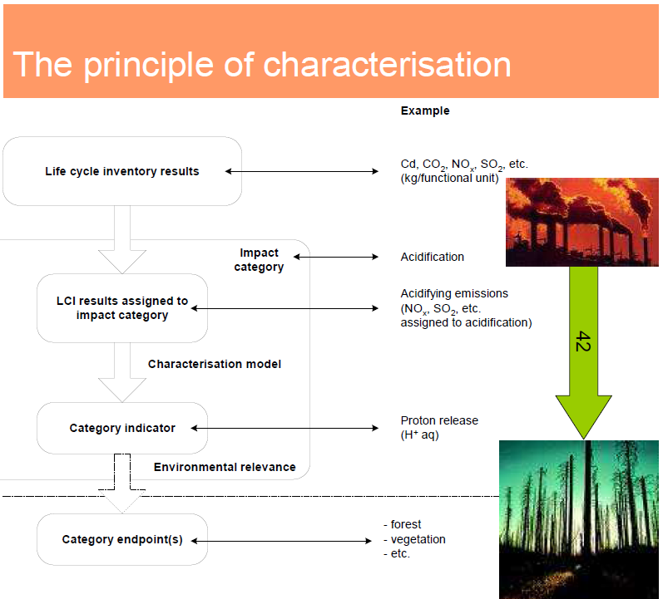

Slide 14
Elementary flow
material or energy entering the system being studied that has been drawn from the environment without previous human transformation, or material or energy leaving the system being studied that is released into the environment without subsequent human transformation
Source ISO 14044

Slide 15
Examples of elementary flows
Mineral ores
  Lead ore, in ground
  Lead, 5.0% in sulfide, Pb 3.0%, Zn, Ag, Cd, In, in ground
  Lead, Pb 0.014%, Au 9.7E-4%, Ag 9.7E-4%, Zn 0.63%, Cu 0.38%, in ore, in ground
Fuels
  Coal, brown in kg
  Coal, brown, 10.0 MJ per kg, in ground in kg
  Coal, brown, 14.1 MJ per kg, in ground in kg
  Energy from brown coal in MJ
Land occupation and transformation
  Occupation, arable, conventional tillage in m2.years
  Transformation, from arable, non-irrigated, extensive in m2

Slide 16
Examples of elementary flows
Soil –Raw material input
  Carbon, in organic matter, in soil
  Clay and soil, extracted for use
  Clay and soil, related unused extraction
  Soil, unspecified, in ground
Emission to air
  Particulates
  Particulates Matter >10um
  Particulate Matter 10.0 um
  Particulate Matter 2.5 um

Slide 17
Examples of elementary flows
Water emissions
  Soil loss by erosion into water
  Organic substances, unspecified
  Solved substances
  Solved substances, inorganic
  Suspended substances, unspecified
  Salts, unspecified
  Acidity, unspecified
Soil emissions
  Salts, unspecified
  Acidity, unspecified

Slide 18
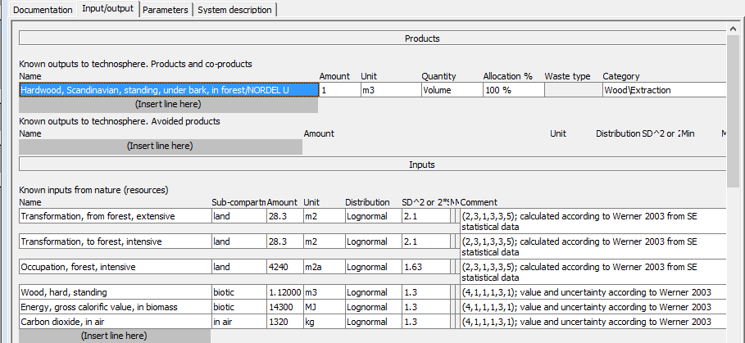
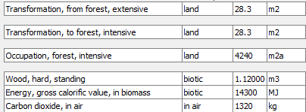
Examples of elementary flows
Biomass

Slide 19
How many elementary flows are there
In SimaPro
  Raw materials 1800
  Air emissions 4700
  Water emissions 3700
  Soil emissions 3400
  Also emission sub-compartments for air water and soil emissions
Air | Water |  | Soil
non-urban air or from high stacks | ground- |  | agricultural
low population density, long-term | ground-, long-term |  | forestry
lower stratosphere + upper troposphere | ocean |  | industrial
urban air close to ground | surface water |  | unspecified
indoor | unspecified
unspecified

Slide 20
How to position the elementary flow.
Elementary flow definitions should enable meaningful aggregation in the impact assessment model.
Timber production
  Flow of standing hardwood, in mass units, - or
  Land occupation in area time and land transformation in area?
  Which is better to aggregate and predict effects on biodiversity?

Slide 21

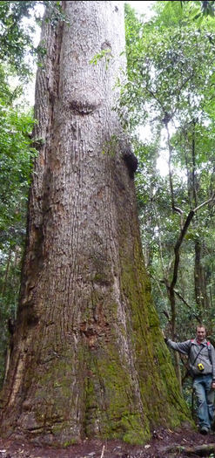



Adding up the trees
= ?

Slide 22
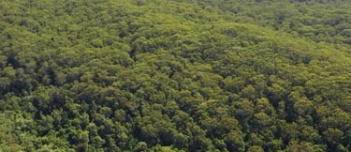
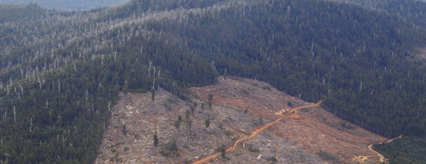
Area of land use change
= ?

Slide 23

New types of elementary flows
Social Hot Spot database – risk levels used for attributes
Risk of Child Labor in sector, Female , VHR
Risk of Child Labor in sector, Female , HR
Risk of Child Labor in sector, Female , MR
Risk of Child Labor in sector, Female , LR
Risk of Child Labor in sector, Female , URL
Risk of Child Labor in sector, Female = ne

Slide 24
New types of elementary flows
Water footprint flows – adding geography to elementary flows
Water, lake, AE
Water, lake, AF
Water, lake, AL
Water, lake, AM
Water, lake, AO
Water, lake, AR
Water, lake, AT
Water, lake, AU
Water, lake, AZ
Water, lake, BA
Water, lake, BD
Water, lake, BE
Water, lake, BF

Slide 25
The environmental mechanism – example of human toxicity
Emissions in compartment m
Fraction transferred to n
Chemical
fate
Intake
fraction iF
Time integrated concentration ↑ in n
Human
exposure
Dose taken in
Potency
(Dose -
response)
Risk of affected
persons
Effect
factor
Damage on
human health
Severity
(ES&T 2002, 36, 207-212 A)

Slide 26
Current approaches to land use
Biodiversity metrics based:
  Direct occupation of land – displacing biodiversity and stopping it re-establishing on that land
  Increased segregation of remaining natural land.
Japanese LIME model included NPP as an endpoint in LCA.
Ecological footprint- based on exclusive use of land based on NPP.
ILCD – carbon deficit from land use change.
World impact+ method – focus on regionalisation of impact assessment – included soil ecological functions – erosion resistance, water supply, water filtration.

Slide 27
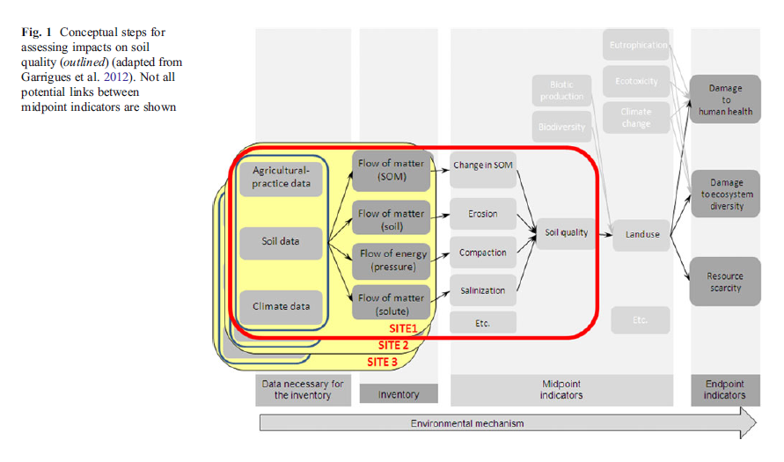
The scope of our work for the next two days
Source: Garrigues et al. 2013. Development of a soil compaction indicator in life cycle assessment. International J Life Cycle Assessment 18:1316.

Slide 28
Back to Sandra
Current flows in AusAgLCI to cover impact categories
Inventory produced to date
Some LCI results
Expectations from the workshop

Slide 29
Impact categories
Global warming:
  Flows are based on IPCC (2006) and National Inventory Report (DCCEE 2011) methodologies.
  Emissions directly associated with production (e.g. direct and indirect GHG emissions from fertiliser use, burning of stubble, crop residues) are included as inventory flows but not potential carbon sinks and sources (soil, litter and vegetation carbon changes); it will be the domain of the LCA practioner to add these where appropriate.
Water use:
  Elemental flows required to support a range of impact assessment approaches are included. Green water is included if there is a land transformation that changes the availability of water downstream for other users.
Land use:
  The land cover classifications used by ecoinvent® are used as the basic flow in the inventory.
  To inform the discussion on land use and the competing demands for land, an approach that classifies both area and the capacity of land to produce food is required.

Slide 30
Impact categories - continued
Eutrophication:
  Nitrogen flows are estimated using Australian NIR methodology and phosphorus flows are estimated by the method used by ecoinvent®.
  Both methods are responsive to fertiliser inputs, and use regional data (at the intersection of GIS layers for agro ecological region and land use) to determine if leaching and run-off is occurring, and to estimate net export of soil (relevant for P transport to waterways).
Ecotoxicity:
  Flows of specific active ingredients to soil, water and air are estimated from PestLCI, adapted to Australian conditions.
  Parameters modified for Australian conditions are climate related (temperature, precipitation, evaporation, solar radiation), soil characteristics (depth, proportion sand, silt and clay, pH, organic content, bulk density), and field data (slope).
  Profiles for use in PestLCI have been constructed from GIS layers at the intersection of agricultural land use and agro ecological region.
  A number of pesticides used in Australia have been added to the model, using readily available data on key parameters (molecular weight, solubility, vapour pressure, half life in soil).
Notes:
The methods do not take into account more detailed spatial and temporal variation in weather and soil conditions. Approaches to quickly locate relevant data on nutrient flows at this finer scale were investigated, in the first instance using BiosEquil (Raupach et al. 2001). The work required to successfully complete this was beyond the scope of the project but would be a sensible future investment.

Slide 31
What has been produced to date
Sector | Processing | Material | Total
Cotton | 14 | 4 | 18
Horticulture | 17 | 16 | 33
Livestock* | 2 | 12 | 14
Grains | 19 | 16 | 35
Sugar | 13 | 7 | 20
Irrigation |  |  | 23
Other |  |  | 4
Total |  |  | 147
* Supporting inventory

Slide 34
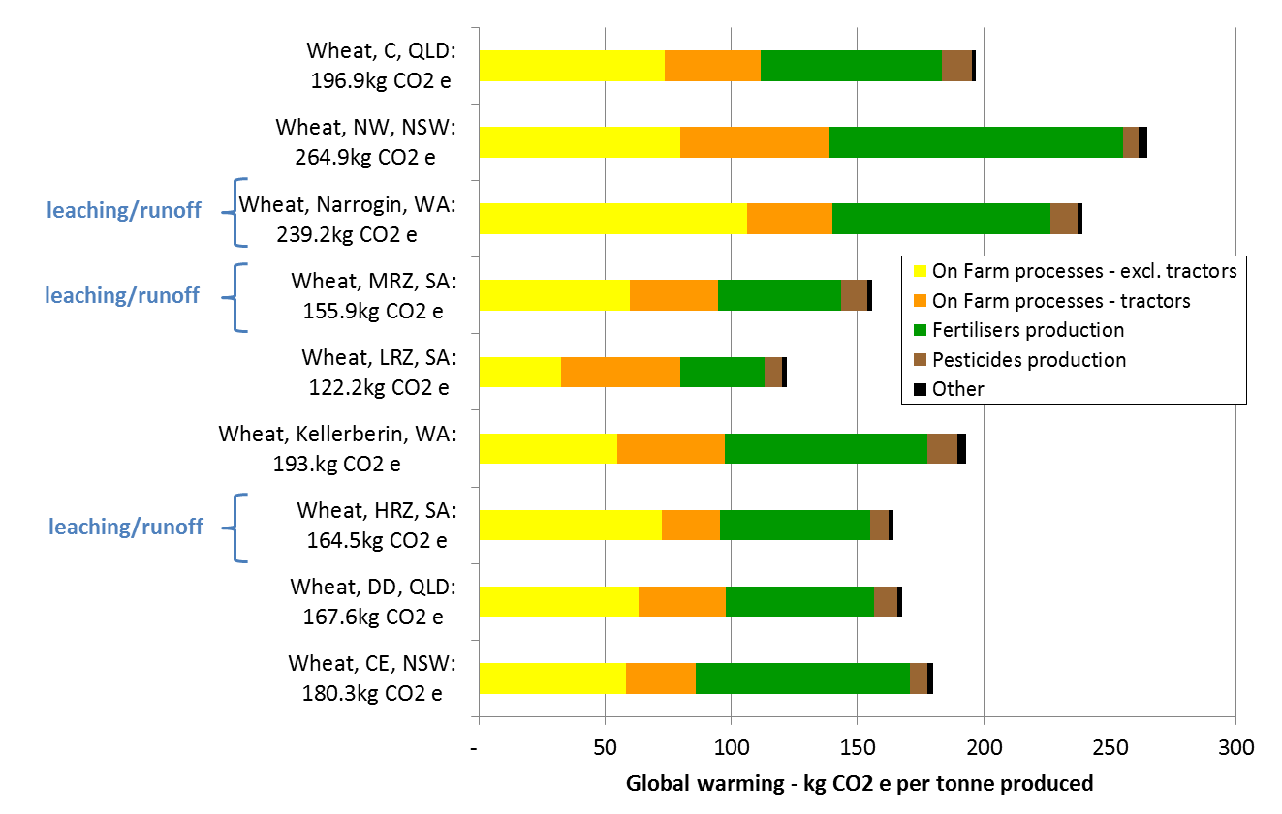
Preliminary Wheat GHG Results

Slide 35
The scope of our work for the next two days
Day 2
Day 1
Source: Garrigues et al. 2013. Development of a soil compaction indicator in life cycle assessment. International J Life Cycle Assessment 18:1316.

Slide 36
Sustainable Agriculture
  Sandra Eady
  Project leader
    t +61 2 6776 1394
    e sandra.seady@csiro.au
    w www.csiro.au
Life Cycle Strategies
  Tim Grant
  Project Partner
    t +61 3 8669 2048
    e tim@lifecycle.com.au
    w www.lifecycles.com.au
CSIRO Sustainable agriculture flagship

