Slide 1
International developments in Life Cycle Impact Assessment of Land Use
Dr. Miguel Brandão
Massey University

Slide 2
International Activities
European Commission
  ILCD Handbook
  PEF and OEF
UNEP/SETAC Life Cycle Initiative
  Guideline on Global Land Use Impacts on Biodiversity and Ecosystem Services in LCA
  Biotic Production Potential
  Carbon Sequestration Potential
  Case Study

Slide 3
The ILCD Handbook
Superseded by PEF/OEF

Slide 4


European Commission recommendations
Methods evaluated against:
  Scientific criteria
    Completeness of scope
    Environmental relevance
    Scientific robustness and certainty
    Documentation, transparency and reproducibility
    Applicability
  Stakeholder acceptance criterion
    Degree of stakeholder acceptance and suitability for communication in a business and policy context
Dr. Miguel Brandão
Test Public Lecture: The assessment of resource scarcity in LCA

Slide 5
Scoring procedure
A: Full compliance
B: Compliance in all essential aspects
C: Compliance in some aspects
D: Little compliance
E: No compliance
Dr. Miguel Brandão
Test Public Lecture: The assessment of resource scarcity in LCA

Slide 6
ILCD LCIA method recommendation levels
Level I: Recommended and satisfactory
Level II: Recommended, some improvements needed
Level III: Recommended, but to be applied with caution
Interim: Immature for recommendation but the most appropriate among existing approaches
Dr. Miguel Brandão
Test Public Lecture: The assessment of resource scarcity in LCA
Notes:
2.2 Recommendation levels
The recommended characterisation methods (models and associated characterisation
factors) are classified according to their quality into three levels: “I” (recommended and
satisfactory), “II” (recommended but in need of some improvements) or “III” (recommended,
but to be applied with caution). A detailed description of the levels is provided below:
8 Available at http://lct.jrc.ec.europa.eu
ILCD Handbook: Recommendations for Life Cycle Impact Assessment in the European context First edition
10
2 Recommended methods for impact categories
Level I: Recommended and satisfactory
Definition: These models and characterisation factors are recommended for all types of
life cycle based decision support. Although further research needs may have been identified,
these are not preventing the models/factors being seen as satisfactory given the current
state-of-the art. However, updating and improvement via established mechanisms, such as
e.g. the IPCC, should be followed also for these methods and factors.
Level II: Recommended, some improvements needed
Definition: The models and characterisation factors are recommended for all types of life
cycle based decision support. The uncertainty of models and the resulting characterisation
factors is to be more strongly highlighted. The impact on results and interpretation has to be
more carefully evaluated, especially in published comparisons. The need for dedicated
further research is identified for these methods/factors to further improve them in terms of
precision, differentiation, coverage of elementary flows etc.
Level III: Recommended, but to be applied with caution
Definition: These models and characterisation factors are recommended to be used but
only with caution given the considerable uncertainty, incompleteness and/or other
shortcomings of the models and factors. These models/factors are in need of further
research and development before they can be used without reservation for decision support
especially in comparative assertions. The recommendation is to calculate and present the
results of the LCIA with and without methods that are level III and to discuss the differences,
e.g. in the interpretation of the LCA. It is also recommended to conduct sensitivity analyses
applying – if available - other methods than the level III recommended ones and to discuss
differences in the results, e.g. in the interpretation of the LCA. However, the level III
recommended method should remain the baseline.
Interim: immature for recommendation but the most appropriate among the existing
approaches
Definition: The methods and characterisation factors defined as interim are to be used
only with extreme caution, and limited to in-house applications, given the considerable
uncertainty, incompleteness and/or other shortcomings of the methods and factors.
Note that for some impact categories there were no existing models and factors that met
the criteria for level III. For these impact categories no method is recommended in the ILCD
System, as the level of maturity and/or available documentation is considered too limited to
facilitate general use.
The fact that an impact category at midpoint or endpoint has no recommended methods
hence does not mean that it is not relevant to include in a study, but merely that at the
moment no existing method was found sufficiently mature for recommendation.
This should not be taken as a recommendation to exclude this specific impact category,
but to apply a method which has been identified by the practitioner as the current best
practise for the specific application. However, in the study the uncertainties and the
limitations have to be clearly stated, in particular for this impact category.
ILCD Handbook: Recommendations for Life Cycle Impact Assessment in the European context First edition
11
2 Recommended methods for impact categories
In specific situations, even if there is a recommendation to use a LCIA method, the use of
a different LCIA method could be accepted, provided that two conditions are met:
1. The LCIA method different from the recommended method is more suitable for the
circumstances of the specific case
2. The LCIA method is in compliance with ILCD requirements.
To 1: This can be relevant especially in case of specific geographical relevance of the
chosen model (models or factors developed for a specific country/ climate etc.). It has to be
justified that this will significantly reduce the uncertainty associated with the impact
assessment in the particular life cycle assessment, and it has to be justifiable in accordance
with the goal of the study.
To 2: In the ILCD Handbook “Review schemes for Life Cycle Assessment”, minimum
review requirements for LCIA are listed. An independent external review is requested for
LCIA factors, whereas an independent panel review is requested for the underlying LCIA
models.
Any deviation from the recommended LCIA method has to be justified and the
recommended LCIA method has to remain the baseline for comparison and it has to be
reflected in the interpretation.
Not necessarily all LCIA methods that are recommended within this document are fully
compliant with all ILCD requirements, especially related to the requirements for review of
LCIA models and factors. However the recommendation reflects that after expert and public
consultations these methods were seen as being of sufficient quality. Until the methods
comply with all ILCD requirements, they may be considered a preliminary recommendation.

Slide 7
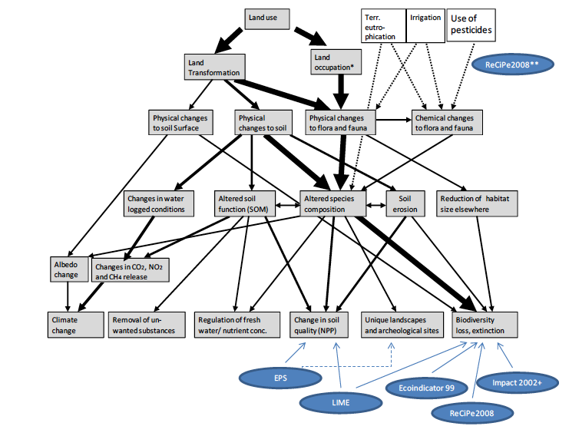
Land Use cause-effect chain

Slide 8
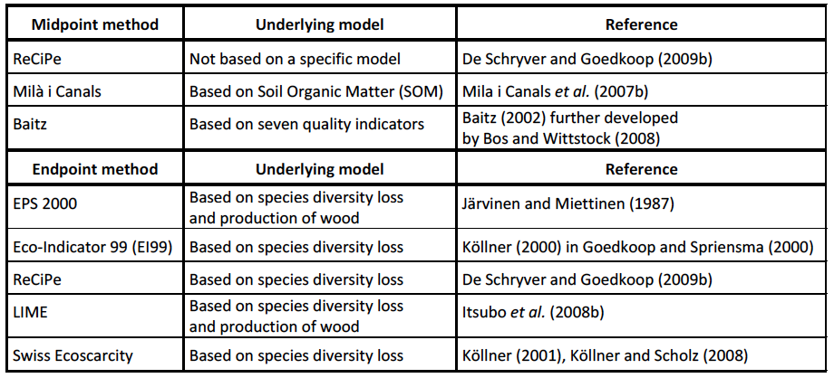
ILCD selected methods and underlying models
Dr. Miguel Brandão
Test Public Lecture: The assessment of resource scarcity in LCA

Slide 9
Sub-criteria for Land Use
Specific underlying model
Land transformation
Land occupation
Duration of physical changes
Quantitative changes to fauna and flora
Physical changes to soil
Effects on climate change
Effects on Net Primary Production
Biodiversity loss
Dr. Miguel Brandão
Test Public Lecture: The assessment of resource scarcity in LCA

Slide 10
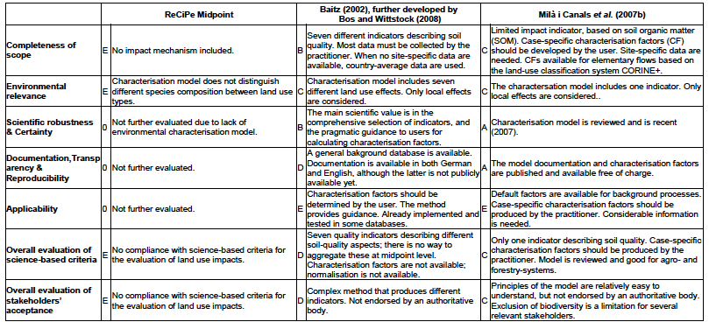
Analysis of midpoint methods
(ILCD, 2011)

Slide 11
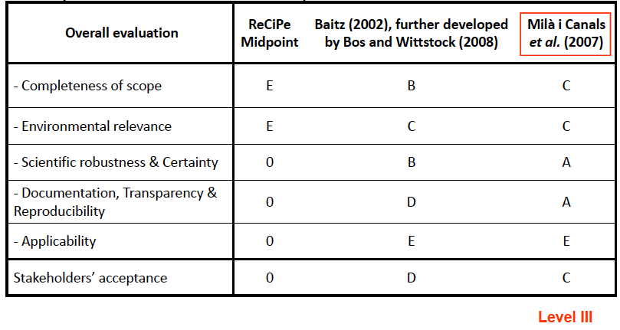
Midpoint method evaluation
(ILCD, 2011)

Slide 12
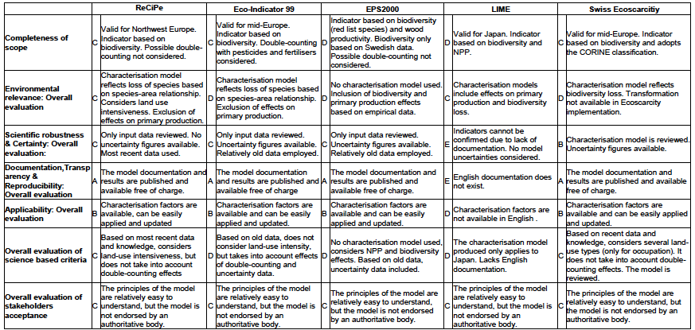
Analysis of endpoint methods
(ILCD, 2011)

Slide 13
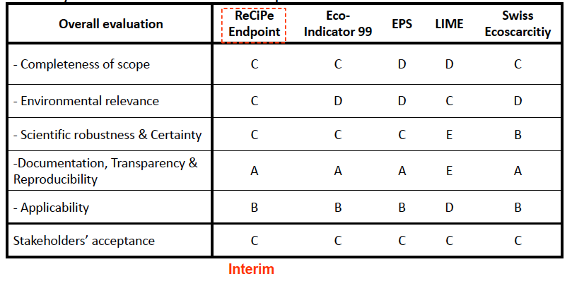
Endpoint method evaluation
(ILCD, 2011)

Slide 14
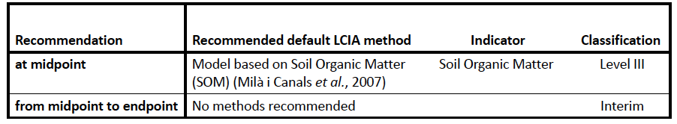
Midpoint method evaluation
(ILCD, 2011)
Dr. Miguel Brandão
Test Public Lecture: The assessment of resource scarcity in LCA

Slide 15



UNEP-SETAC Guideline on Global
Land Use Impacts on Biodiversity and Ecosystem Services in LCA
Thomas Koellner¹, Rosie Saad², Laura de Baan³, Tabea Beck⁴, Ulrike Bos⁴, Miguel Brandão⁵, Barbara Civit⁶, Jan Paul Lindner⁴, Manuele Margni¹, Llorenç Milà i Canals⁷, Danielle Maia de Souza^{2,5} and Ruedi Müller-Wenk⁸
¹U Bayreuth (Germany), ²CIRAIG (Montréal, Canada), ³ ETH Zurich (Switzerland), ⁴ U Stuttgart (Germany), ⁵ JRC (Italy), ⁶ Universidad Tecnológica Nacional (Argentina), ⁷ Unilever - Safety & Environmental Assurance Centre (UK), ⁸ U St. Gallen (Switzerland)

Slide 16
Project description and
Partnership

Slide 17
Land use LCIA: aims of the project
Working group UNEP/SETAC LC Initiative (phase 2):
Harmonize practices and provide principles for Life Cycle Inventories on a global scale
Provide guidelines for LCIA methods based on the recommendations established in phase 1
Provide operational sets of characterization factors for impacts on :
  biodiversity
  services provided by terrestrial ecosystems
Illustrate those findings in study cases

Slide 18
Characterisation factors for land use impacts on biodiversity and ecosystem services
A) Biodiversity Damage Potential
    Local species diversity and functional diversity
B) Ecosystem Services Damage Potential
  B1) Biotic Production
    Capacity of ecosystems to produce biomass
  B2) Carbon Sequestration
    Capacity of ecosystems to uptake carbon from air
  B3) Freshwater Regulation
    a) Capacity of ecosystems to regulate peak flow and base flow of surface water b) Capacity of ecosystems to recharge ground water
  B4) Erosion Regulation
    Capacity of ecosystems to stabilize soil and to prevent sedimentation
  B5) Water Purification
    Chemical, physical and mechanical capacity of ecosystems to clean a polluted suspension of water

Slide 19









Land Use LCIA: an international
collaboration
Core group: complementary parts and case studies
  PES – U Bayreuth
  NSSI - ETH Zürich (Switzerland)
  CIRAIG – École Polytechnique de Montréal (Canada)
  LBP – U Stuttgart (Germany)
  CES - University of Surrey (UK)
  JRC – European Commission (Italy)
  IWOE – University of St. Gallen (Switzerland)
  Unilever - Safety & Environmental Assurance Centre (UK)
  U Tecnológica Nacional (Argentina)

Slide 20
Overview I
Context
Context
Part A: Foundations
UNEP-SETAC Guideline on Global Land Use Impacts on Biodiversity and Ecosystem Services in LCA by Koellner et al.
Part B: Modelling Characterization Factors for Biodiversity
Land use impacts on biodiversity in LCA: a global approach by Laura de Baan et al.
Land use impacts on functional species diversity: proposal of characterization factors to assess effects on ecosystem processes by Maia de Souza et al.
Notes:
20

Slide 21
Overview II
Part C: Modelling Characterization Factors for Ecosystem Services
Global characterisation factors to assess land use impacts on biotic production by Brandão and Milà i Canals
Impact of land use on climate for use in LCA - carbon cycling between ecosystems and the atmosphere by Müller-Wenk and Brandão
Land use impacts on freshwater regulation, erosion regulation and water purification: a spatial approach for a global scale by Rosie Saad et al.
Part D: Application to Case Studies
Land use impact assessment of Margarine by Milà i Canals et al.

Slide 22
Context and general key-elements

Slide 23
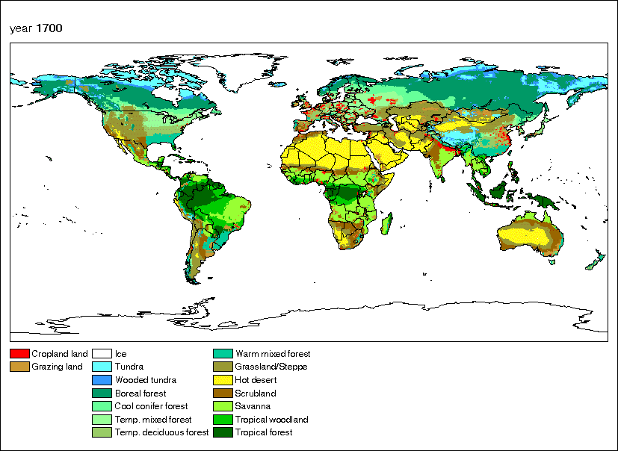
Source: Joint gateway of the Historic Land Use Estimation Efforts by the National Institute of Public Health and the Environment (RIVM, Netherlands) and the Center for Sustainability and the Global Environment (SAGE, USA).
http://www.ncdc.noaa.gov/paleo/ctl/landuse.html

Slide 24
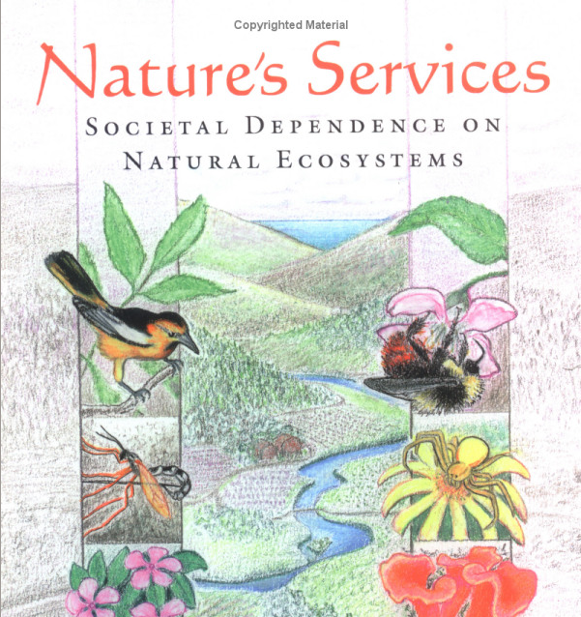
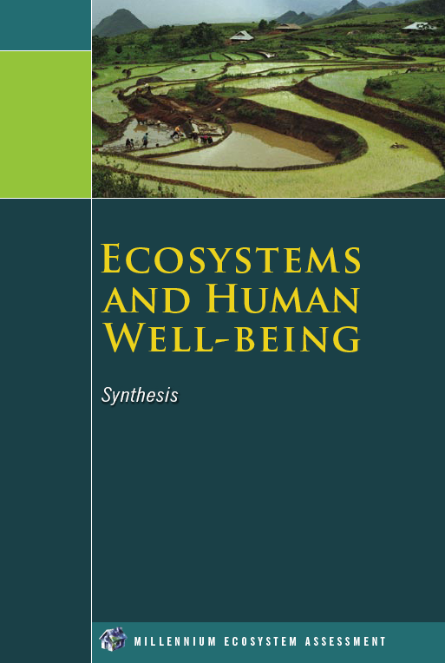
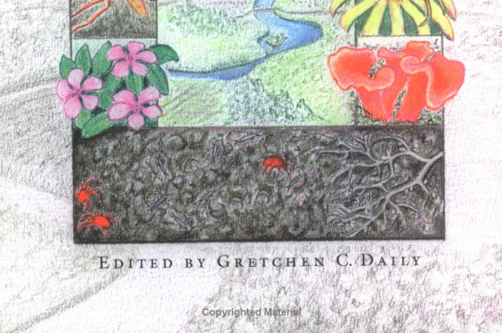
Ecosystem services are functional properties of ecosystems that contribute to human well-being
1997
2004

Slide 25
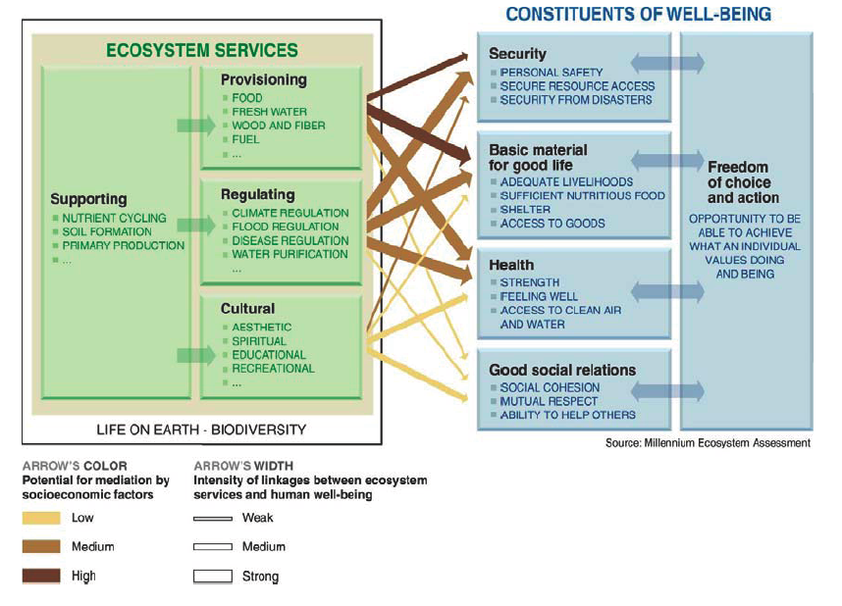
The Millennium Ecosystem
Assessment
Notes:
Ecosystem services are functional properties of ecosystems that contribute to human welfare

Slide 26

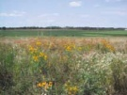
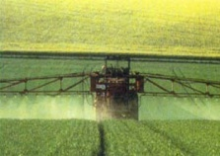
Key-elements: assessment based on a quality curve
Transformation: change of a land area to meet the requirement of a new type of occupation
Occupation: use of a land for anthropogenic purpose
Quality (Q)
Q₀
Impact = A * ∫dQ(t)*dt
Permanents impacts
Q₃
Transformation
Impacts from transformation and occupation
Q₁
Area (A)
Regeneration
Q₂
Occupation
t₁
t₂
t₃
Time (t)
Curve adapted from Milà i Canals et al. (2007)
Notes:
26

Slide 27
Outcome and results

Slide 28
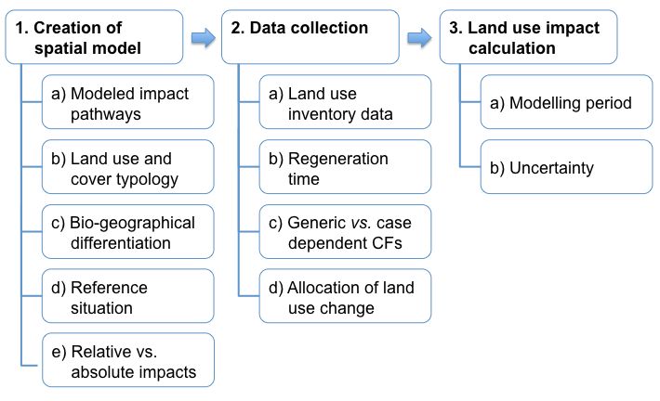
Recommendation for several key-elements (LCA practitioner / developer)
28

Slide 29
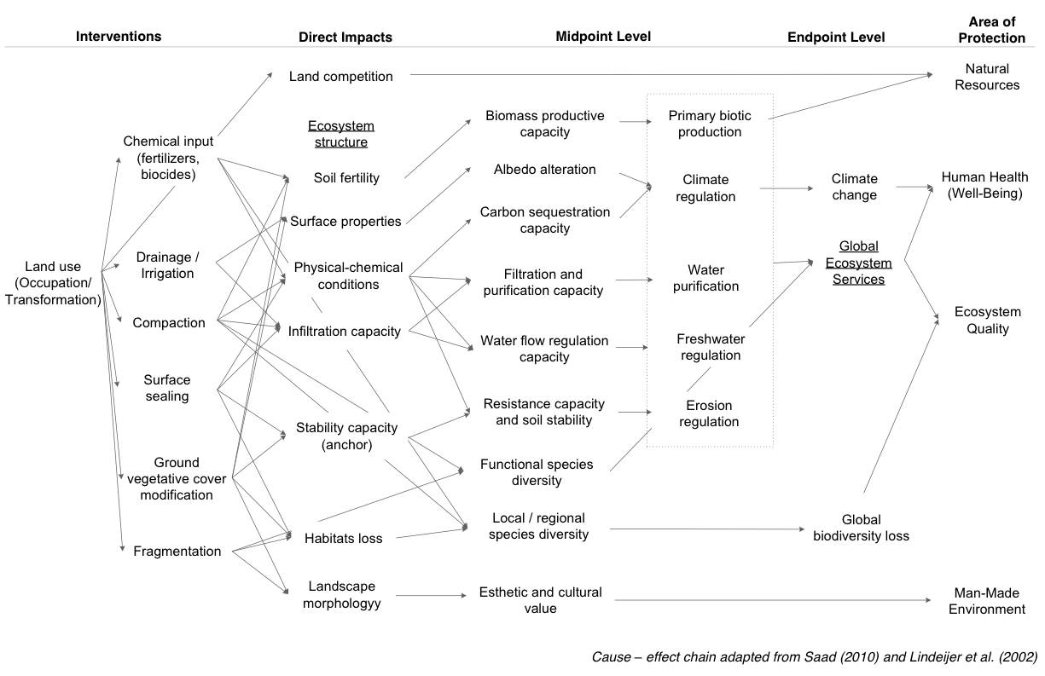
Impact assessment: Cause - effect chain

Slide 30
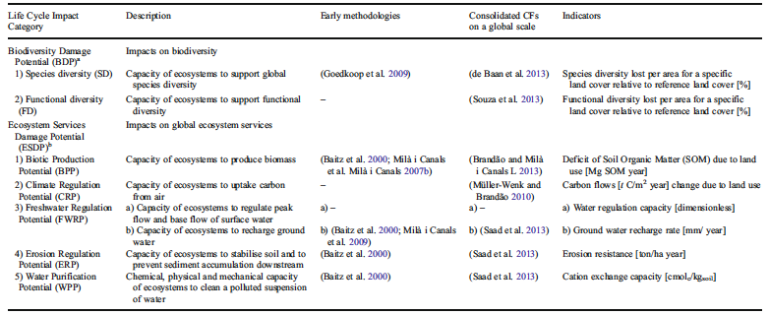
Indicators adopted
Source: Koellner et al. (2013)

Slide 31
Elementary flow and land-use typology in LC inventories
Elementary flows:
  Land occupation : [m²*years], land use type _{i} and region _{k}
  Land transformation : [m²], initial land use type _{i -> j} , region _{k}
Hierarchical land use classification on global scale:
  Level 1 : very general land use and land cover classes (from GLC 2000)
  Level 2 : refines level 1 (mainly from ecoinvent v2.0 and GLOBIO3 classification)
  Level 3 and level 4 : mostly specify land management and the intensity of land uses
31

Slide 32
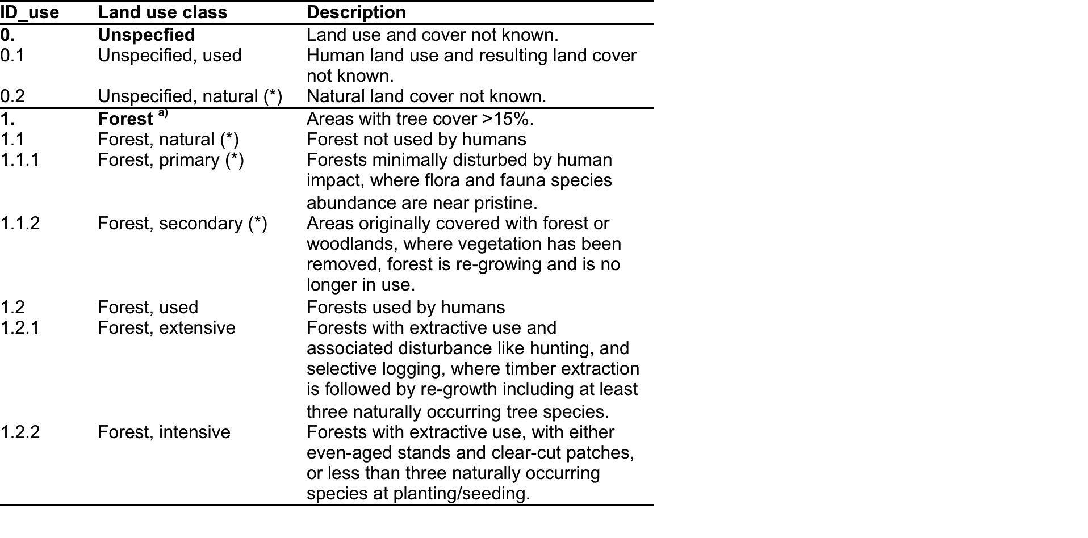
The (*) marks land cover types, which serve as a natural reference.

Slide 33
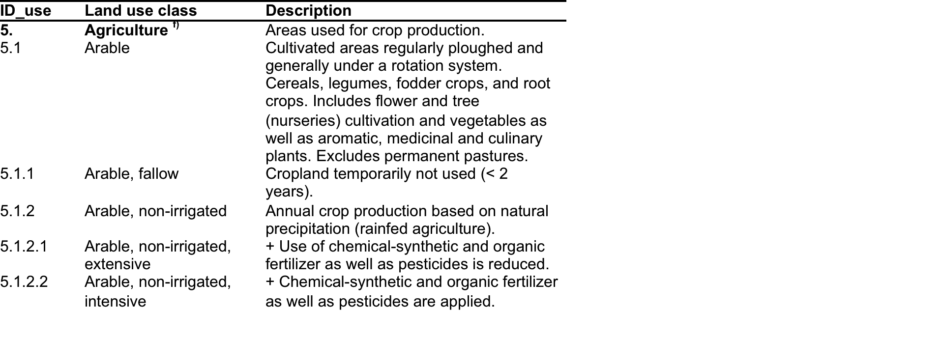

Slide 34
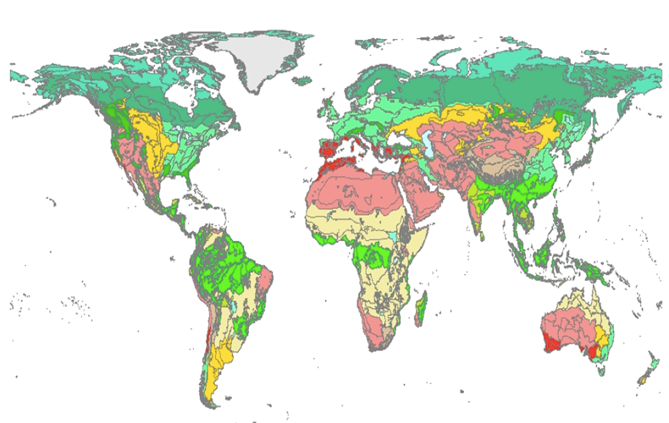
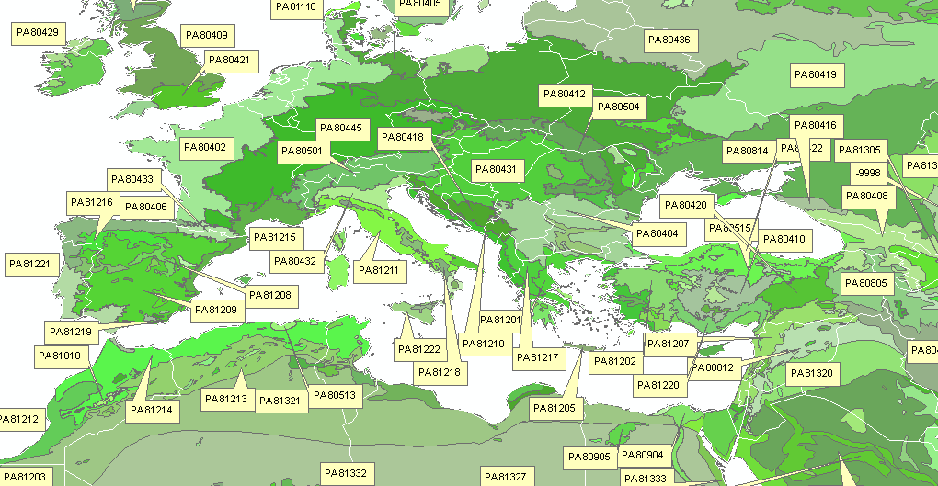
Generic assessment
Geographical detailed assessment
Regionalization in LC inventories
Hierarchical regionalization on global scale :
  Level 1: Differentiation between terrestrial biomes, freshwater biomes, coastal water and shelf/deep sea biomes
  Level 2: Climatic regions ((sub)tropical, temperate, boreal, polar)
  Level 3: Terrestrial and freshwater biomes (n=16), marine biomes (n=3)
  Level 4: Olson terrestrial and freshwater ecoregions (n=867 and n=238 priority regions)
  Level 5: Exact geo-referenced information of land use
34

Slide 35

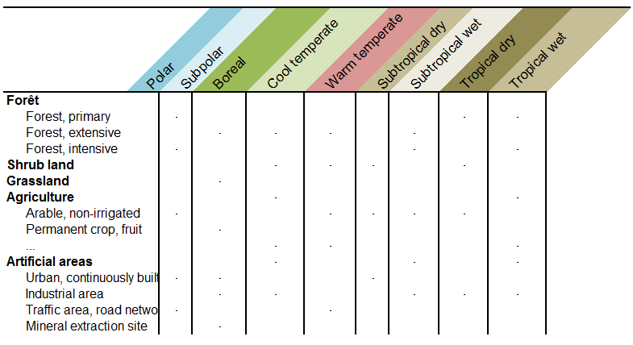
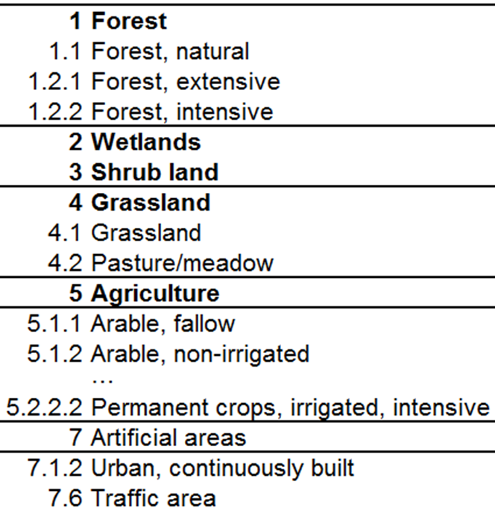
Cross tabulation: land use types and regions
  To account for a spatial differentiated impact analysis :
  Zoning by ecological units using level 1 to 5 of hierarchical regionalization
  Land use types classification (Level 1 to 4) used in Ecoinvent
35

Slide 36
Cross tabulation: land use types and regions
  To account for a spatial differentiated impact analysis :
  Zoning by ecological units using level 1 to 5 of hierarchical regionalization
  Land use types classification (Level 1 to 4) used in Ecoinvent
  Advantages :
  Specific inventory versus cost
  Management of input data and coping with spatial variability
  Processing significant amounts of data (GIS software)
  Defining an appropriate spatial resolution scale for background and foreground systems in LC inventories
36

Slide 37
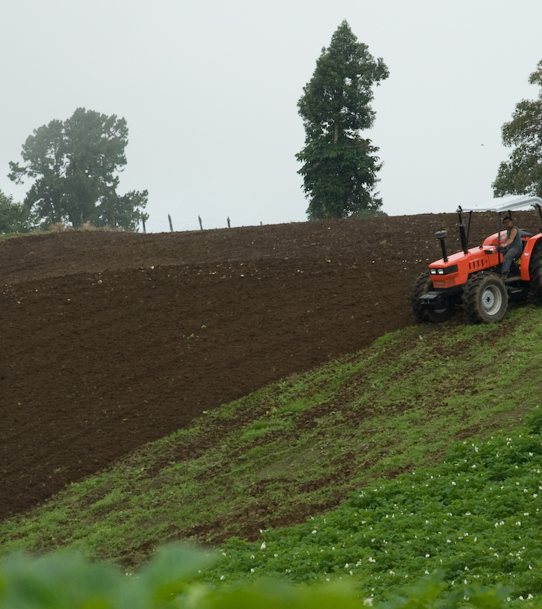
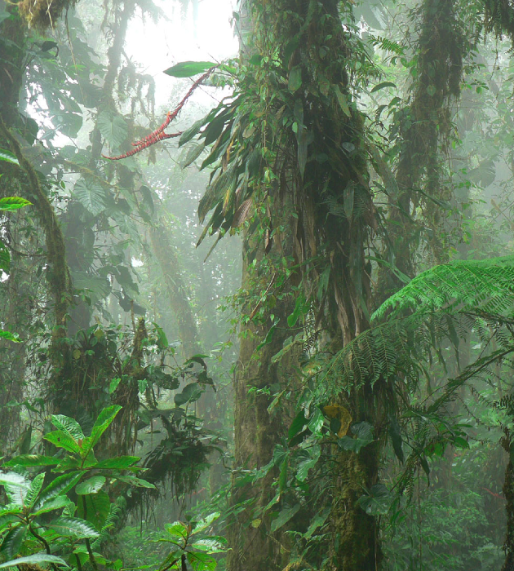
Assessment of actual land use against reference in the region
Land use in the product system
Natural situation as reference

Slide 38
Concluding remarks

Slide 39
Concluding remarks
Comprehensive framework suggesting relevant land use impact pathways
Operational characterization factors for a worldwide application
Guidance for the developers of regionalized impact assessment method:
  To choose the appropriate level of sophistication and resolution
  To adapt the method to a specific national / regional context
Influence of value choices made explicit (reference situation, regeneration time, modeling period, etc.)
Further aggregation to archetypical situation of land use types x region,
  e.g., land transformation from forest to cropland in mountainous regions
The challenge of details v/s practicality and the effort in data collection:
  For foreground systems land use/location might be known in detail
  For the background system land use/location might be partly known or unknown
Application in industry needed

Slide 40
Special issue in the International Journal of LCA
  Global Land Use Impacts on Biodiversity and Ecosystem Services in LCA within the framework of the UNEP/SETAC Life Cycle Initiative
  Editors: Koellner, T. and Geyer, R.
  Part A: Foundations in land use impact assessment and inventories
  Part B: Modelling Characterization Factors for Biodiversity
  Part C: Modelling Characterization Factors for Ecosystem Services
  Part D: Application to Case Studies
Notes:
40
we need tens of case studies in order to get more confidence of which impact pathways tend to overlap, which are more challenging to collect information

Slide 41
Papers of the special issue
Part A: Foundations
Koellner T, L de Baan, T Beck, M Brandão, B Civit, M Margni, L Milà i Canals, R Saad, D Maia de Souza and R Müller-Wenk (2013): UNEP-SETAC Guideline on Global Land Use Impact Assessment on Biodiversity and Ecosystem Services in LCA. Int J LCA.
Koellner T, L de Baan, T Beck, M Brandão, B Civit, M Goedkoop, M Margni, L Milà i Canals, R Müller-Wenk, B Weidema and B Wittstock (2013): Principles for Life Cycle Inventories of land use on a global scale. Int J LCA.
Part B: Modelling Characterization Factors for Biodiversity
de Baan L, R Alkemade and T Koellner (2013): Land use impacts on biodiversity in LCA: a global approach. Int J LCA.
Maia de Souza D, D Flynn, R Rosenbaum and T Koellner (2013): Land use impacts on functional species diversity: proposal of characterization factors to assess effects on ecosystem processes. Int J LCA.
Part C: Modelling Characterization Factors for Ecosystem Services
Brandão M, L Milà i Canals (2013) Global characterisation factors to assess land use impacts on biotic production. Int J LCA DOI:10.1007/s11367-012-0381-3
* Müller-Wenk R and M Brandão (2011): Climatic impact of land use in LCA—carbon transfers between vegetation/soil and air. Int J LCA 15: 172-182.
Bos U, T Beck, J P Lindner and B Wittstock (2013): Land use impact assessment of ecosystem services according to LANCA. Int J LCA.
Saad R, T Koellner and M Margni (2013): Land use impacts on freshwater regulation, erosion regulation and water purification: a spatial approach for a global scale level. Int J LCA.
Part D: Application to Case Studies
Milà i Canals L, G Rigarlsford G, S Sim (2013) Land use impact assessment of Margarine. Int J LCA DOI:10.1007/s11367-012-0380-4
Notes:
Biofuels in Argentina by Barbara Civit, Laura de Baan, Miguel Brandao et al.
http://dx.doi.org/10.1007/s11367-012-0381-3
http://dx.doi.org/10.1007/s11367-012-0380-4

Slide 42

Global Characterisation Factors to Assess Land Use Impacts on Biotic Production
Miguel Brandão, Llorenç Milà i Canals

Slide 43
Contents
Context: modelled impact pathway
Indicators for Biotic Production Potential
Data sources for land uses and bio-geographical coverage
  Reference situation
LCI data
Needs for further research

Slide 44
Objective
To provide operational characterisation factors (CF) to assess impacts on Biotic Production Potential (BPP) in LCA:
Global Coverage
Spatial differentiation (biomes; climate zones)
Relevant for different land use types / life cycle stages
  i.e. including bio-productive (agriculture, forestry…) and non-bio-productive (road, mine…) uses

Slide 45
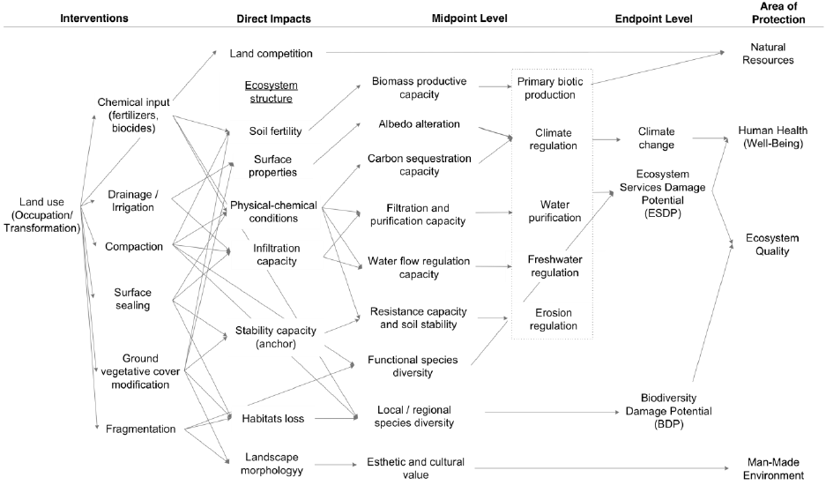
Biotic Production Potential,
BPP

Slide 46
Indicators for BPP
BPP refers to the conditions of land that determine its short, medium and long-term inherent ability to produce and sustain biomass
Review of indicators for BPP
Indicator | Reference
Back-up technology (endpoint) | Stewart and Weidema (2005)
Net Primary Production, NPP | Weidema and Lindeijer (2001)
Human Appropriation of Ecosystem Carbon Stock, HAPECS | Brandão et al. (2010)
Erosion | Cowell and Clift (2000)
Salinisation | Feitz and Lundie (2002)
Energy/exergy | Wagendorp et al. (2006)
Microbial biomass and diversity | Peixoto et al. (2006)
Soil organic carbon, SOC | Milà i Canals et al. (2007)

Slide 47
SOC as indicator for BPP
Soil Organic Carbon (SOC) is a robust, stand-alone indicator for BPP
  Also recommended in ILCD (European Commission 2010)
Data are increasingly available, e.g. through IPCC (2006)
  SOC in different soil types and land uses in world climate zones
  Effects from land management on SOC
Reference situation: SOC present in (quasi-)natural land cover predominant in global biomes and ecoregions
Impact measured as “Carbon deficit” (or credit) [kg C year]

Slide 48
Some SOC values
(tonnes C ha⁻¹ in 0-30 cm depth)
CLIMATE REGION | AREA (km²) | Relative (%) | Permanent Grassland | Long-term Cultivated | Native Ecosystem | Set-Aside | Paddy Rice
Tropical Dry | 30,553,142 | 22.8 | 36.4 | 37.1 | 37.2 | 36.4 | 38.7
Tropical Montane | 7,351,295 | 5.5 | 65.0 | 76.3 | 70.9 | 72.7 | 74.8
Warm Temperate Moist | 5,528,026 | 4.1 | 79.2 | 81.4 | 78.0 | 77.4 | 80.9
Warm Temperate Dry | 12,631,558 | 9.4 | 36.9 | 38.1 | 37.2 | 37.5 | 37.7
Cool Temperate Moist | 11,808,612 | 8.8 | 91.3 | 94.3 | 95.0 | 96.0 | 96.6
Cool Temperate Dry | 12,221,975 | 9.1 | 49.1 | 51.4 | 49.2 | 50.3 | 50.3
Boreal Moist | 13,770,293 | 10.3 | 84.1 | 70.9 | 85.1 | 73.8 | 66.1
Boreal Dry | 3,808,837 | 2.8 | 74.9 | 72.7 | 81.8 | 74.1 | 71.8
Polar Moist | 7,565,826 | 5.6 | 42.7 | 36.4 | 46.4 | 36.6 | 25.5
Polar Dry | 1,975,716 | 1.5 | 47.5 | 45.8 | 53.5 | 46.6 | 45.2
Total (without Antarctica) | 134,075,489 | 100.0
Source: extrapolated from IPCC 2006

Slide 49
Calculating CF for BPP
CF for transformation flows:
CF for occupation flows:

Slide 50
LCI data to make this work
Amount of occupation / transformation (i.e. including duration of use for occupation)
Type of land use (agriculture, arable; grassland…)
Location: climatic region / biome
For study-specific CF:
  SOC change due to occupation or transformation
  Regeneration times for transformation

Slide 51
Assumptions, uncertainty
Regeneration time assumed to be always shorter than modelling time (500 years)
  IPCC suggests new steady state reached in 20 years (agricultural / forestry land uses)
  For artificial land uses, regeneration times based on Lindeijer et al. (1998)
  For certain LUC (e.g. removal of topsoil) regeneration time > 500 years might have to be considered
Uncertainty: provided by IPCC 2006 on their land use and management factors (± 10-90%)

Slide 52
Applications
SOC has been used as indicator for BPP / soil quality in several case studies to date (local vs. air-freight vegetables; biofuels; margarine)
  Useful in distinguishing very differentiated systems
  Results strongly influenced by SOC data sources and assumptions such as regeneration time

Slide 53
Discussion, needs for further research
Increasingly abundant data sources for SOC
  IPCC: global coverage, consistency
Factors for permanent crops not provided yet
  Needs for further differentiation?
Allocation of transformation is an inventory issue
  20 years vs. consequential vs. average in a country…
Regeneration times are very uncertain: cautious interpretation of CF for transformation
Link SOC-BPP needs further testing

Slide 54
Impact of land use on climate for use in LCA - carbon cycling between ecosystems and the atmosphere
Miguel Brandão and Ruedi Müller-Wenk

Slide 55
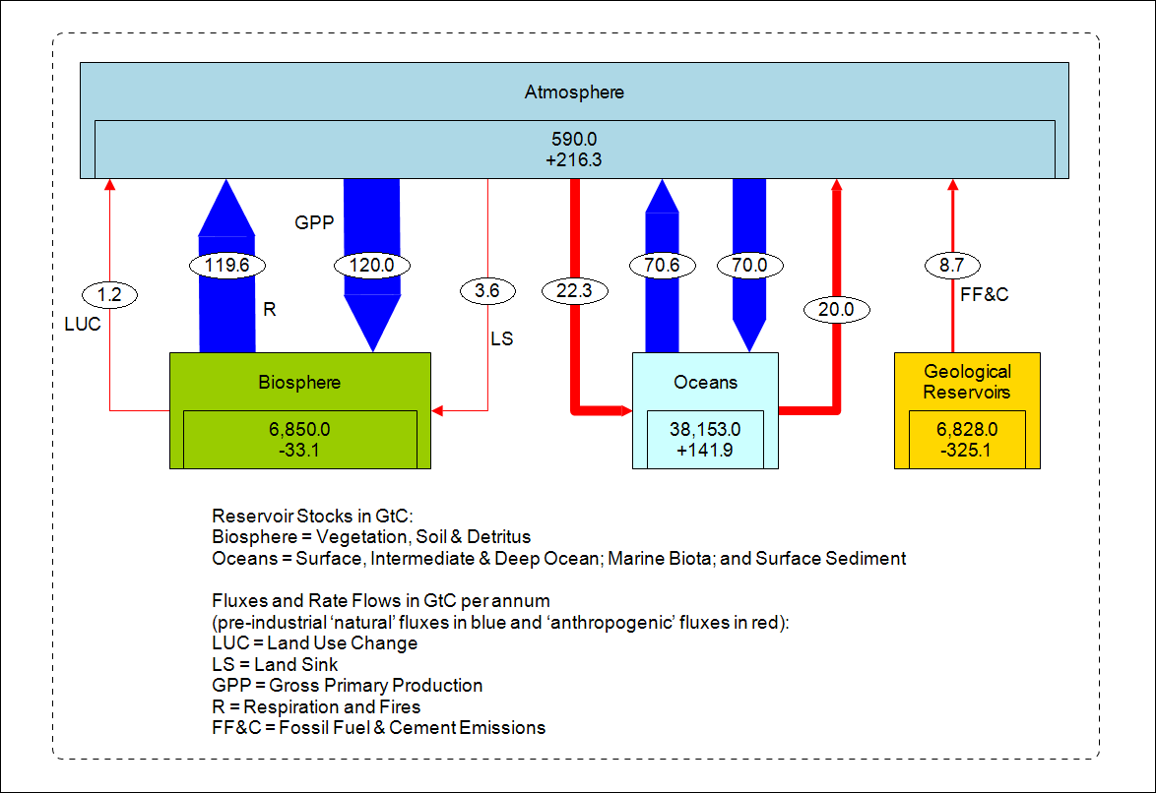
Importance of Land Use in the Global Carbon Cycle
Notes:
Emissions of CO2 from fossil fuel use and from the effects of land use change on plant and soil carbon are the primary sources of increased atmospheric CO2. Since 1750, it is estimated that about 2/3rds of anthropogenic CO2 emissions have come from fossil fuel burning and about 1/3rd from land use change. About 45% of this CO2 has remained in the atmosphere, while about 30% has been taken up by the oceans and the remainder has been taken up by the terrestrial biosphere. About half of a CO2 pulse to the atmosphere is removed over a time scale of 30 years; a further 30% is removed within a few centuries; and the remaining 20% will typically stay in the atmosphere for many thousands of years. {7.3}

Slide 56
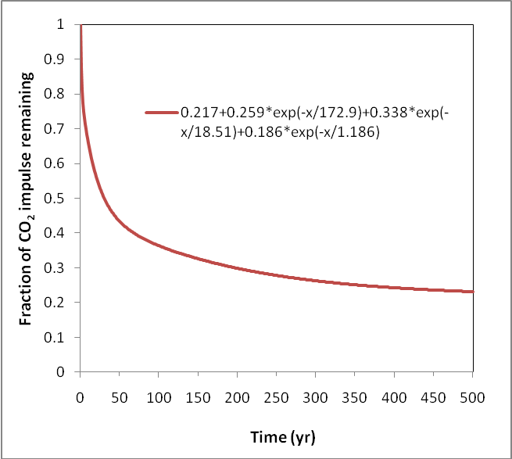
Decay of atmospheric CO₂
Source: equation from IPCC (2007, p.212)
Notes:
Figure 3.25 shows that the airborne fraction of a CO2 unit pulse (e.g. 1 tonne of carbon = 3.67 tonnes of CO2) decreases fast in the first decades after emission. However, not all of the carbon emitted is cycled into other pools. In fact, 56% will still remain in the atmosphere after 20 years, 36% after 100 years and 23% after 500 years (see table 3.6). In other words, 50% of the marginal emission will take 30 years to leave the atmosphere, a further 30% will be removed within a few centuries, and the remaining 20% will take thousands of years {Denman, 2007 #4769}.

Slide 57
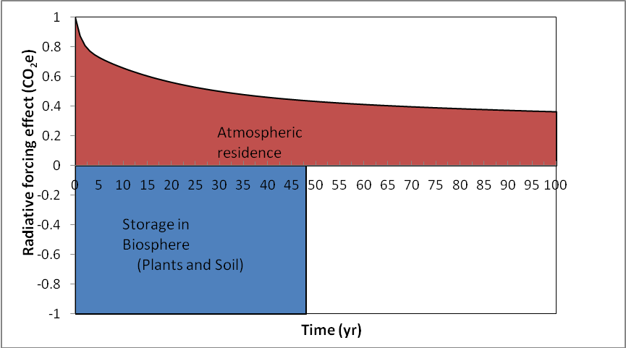
Radiative forcing (W/m²), t CO₂-eq. and t C*yr

Slide 58
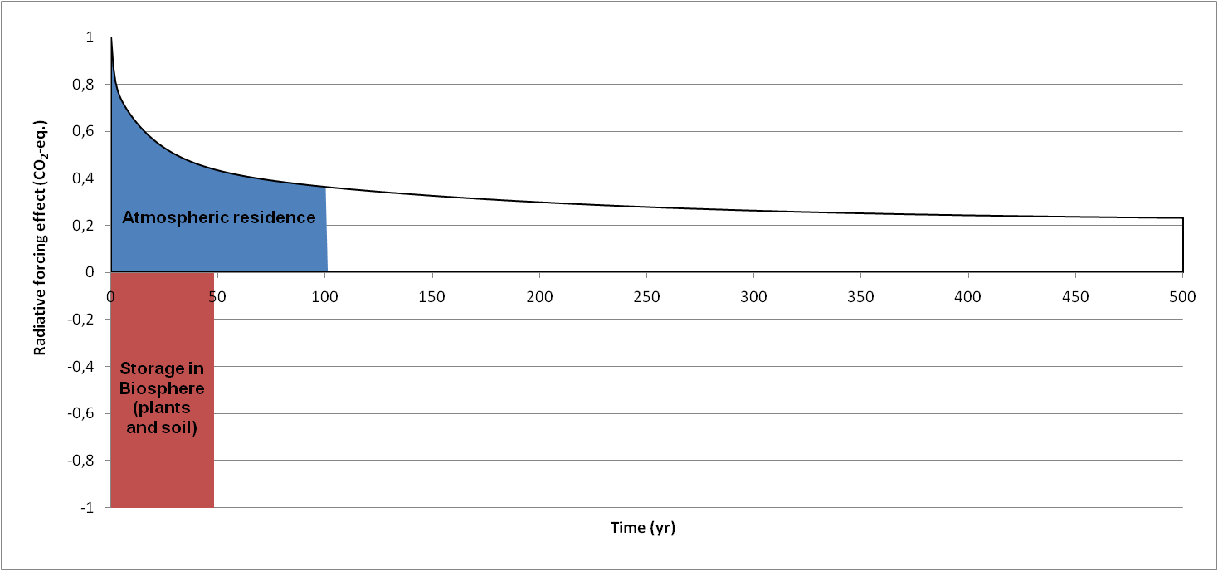
Radiative forcing (W/m²), t CO₂-eq. and t C*yr

Slide 59
Global Warming Potential: the extended Moura-Costa approach
 | Global Warming Potential (CO₂-eq)
 | 20 years | 100 years | 500 years
Carbon Dioxide | 1 | 1 | 1
Methane | 72 | 25 | 7.6
Nitrous Oxide | 289 | 298 | 153
Carbon Dioxide Sequestration (tonne-years) | 1/14.6 = 0.074 | 1/47.8 = 0.021 | 1/157.3 = 0.006
Carbon tonne-years | 0.074*44/12= =0.27 | 0.021*44/12= =0.08 | 0.006*44/12= =0.022
Notes:
CO2 – 85% incl LULUCF

Slide 60
Characterisation Factors
(tC/ha)
Biome | Transformation | Occupation (1 year)
Tropical Forests | 25-55 | 0.77-0.96
Temperate Forests | 24-75 | 0.64-0.86
Boreal Forests | 27-150 | 0.41-0.96
Tropical Grassland | 0-27 | 0-0.37
Temperate Grassland | 0-45 | 0-0.42
Wet Tropical Forests | 39-84 | 1.19-1.48
Dry Tropical Forests | 10-24 | 0.32-0.43

Slide 61
Land Use Impact Assessment of Margarine
Llorenç Milà i Canals, Giles Rigarlsford and Sarah Sim
Special forum on Global Land Use Impacts on Biodiversity and Ecosystem Services in LCA

Slide 62
Contents
Context and Goals
The studied margarines
Methods
  Linking LCI to LCIA: quantifying LU and LUC; sourcing countries / biomes
Results
Discussion
Conclusions

Slide 63

What is Margarine?
Water (dispersed phase)
Protein (e.g. whey, starch, buttermilk)
Fat blend (continuous phase)
Salt
Emulsifiers
Flavourings
Colouring
Antioxidants
Vitamins

Slide 64
Goals
Assessment of applicability and relevance of newly developed characterisation factors (CF)
  Bio-geographical differentiation
  Land use classification
Margarine is a land-based product (through sourcing of vegetable oils)
  Previous studies have addressed common LCA impact categories (Nilsson et al. 2010) and also the water footprint of margarine (Jefferies et al. 2012)
  Key hotspots for land use impacts?

Slide 65


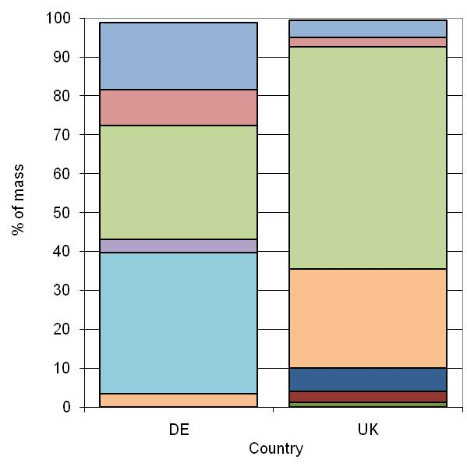


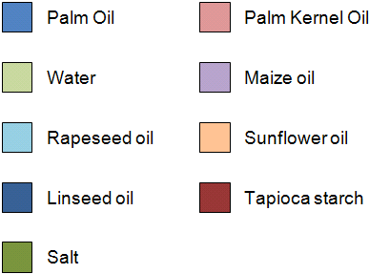
Margarine products considered
Functional unit = 500g tub
70% fat
38% fat

Slide 66
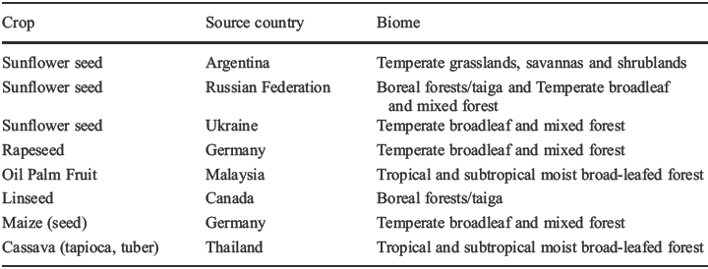
Methods – LCI: sourcing countries
Sourcing country is variable and not always known (commodity markets)
Yield is highly variable: this determines occupation (land use, LU)

Slide 67
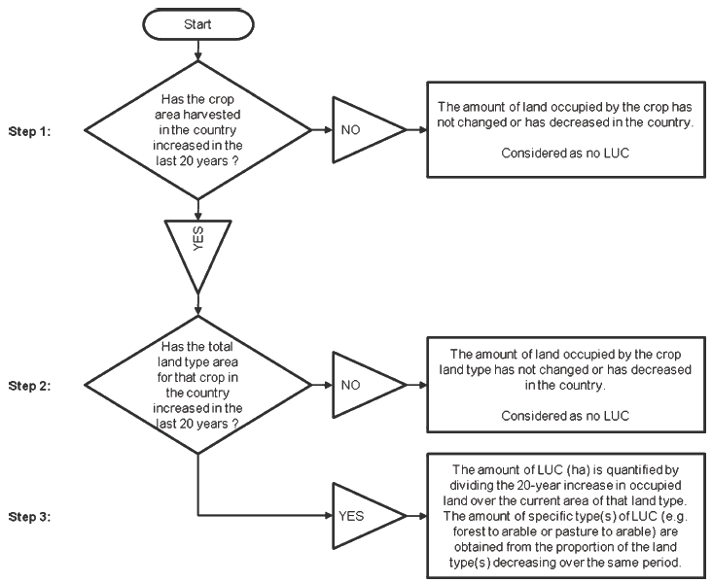
Methods – LCI: land transformation (LUC)
Land transformation (Land Use Change, LUC) was quantified from FAO statistics, considering trend in the specific crop and crop type in the sourcing countries in the last 20 years

Slide 68
Methods – LCIA
Biodiversity Damage Potential, BDP: de Baan et al. (2012)
Climate Regulation Potential, CRP: Müller-Wenk and Brandão (2010)
Biotic Production Potential, BPP: Brandão and Milà i Canals (2012)
Freshwater Regulation Potential (FWRP), Erosion Regulation Potential (ERP), Water Purification Potential- physicochemical filtration (WPP-PCF) and -mechanical filtration (WPP-MF): Saad and Margni (2012)

Slide 69
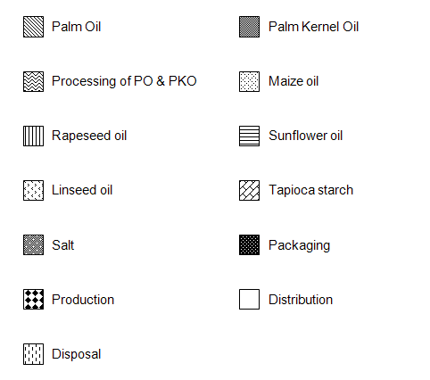
Results– LCIA
a) BDP (Biodiversity) | b) CRP (Climate)
c) ERP (Erosion) | d) FWRP (Freshwater)
Legend

Slide 70
Results– LCIA
e) WPP-MF | f) WPP-PCF
g) BPP
Legend

Slide 71
Discussion
Results
  Occupation dominating the impacts
Applicability
  Sourcing locations for commodities
  Adaptation of background LCI databases
Methodological choices
  Significance of reference situation: potential vegetation vs. current land use mix (GLC 2000)

Slide 72
Conclusions
Spatially differentiated, land-use comprehensive, impact assessment is now possible on a life cycle perspective
  To be added to other impacts: common LCA; water…
Significant work still needed:
  LCI databases: to report land occupation (at least) on a regional (biome?) level
  Land classification proposed is adequate; arable vs. permanent crops need to be distinguished
Agreement needed on how to quantify and allocate LUC
Land use impacts in LCA are in its INFANCY:
More case studies required!
  Overlap between impact categories?
  Value of spatial differentiation?
  Reference: theoretical vs. actual habitat?

Slide 73

Thank you!
Questions?
Llorenc.Mila-i-Canals@Unilever.com
www.unilever.com/sustainability
www.sustainable-living.unilever.com
Special forum on Global Land Use Impacts on Biodiversity and
Ecosystem Services in LCA
Brussels, 17th February 2012

Slide 74
Overview
Use of soil indicators by the international LCA community
Update on how impact assessment methods capture soil-related inventory
Update of international frameworks with reference to soil indicators
Steps for ensuring new approaches are consistent with these

Slide 75
Questions?
m.brandao@massey.ac.nz

Slide 76
APPENDIX

Slide 77
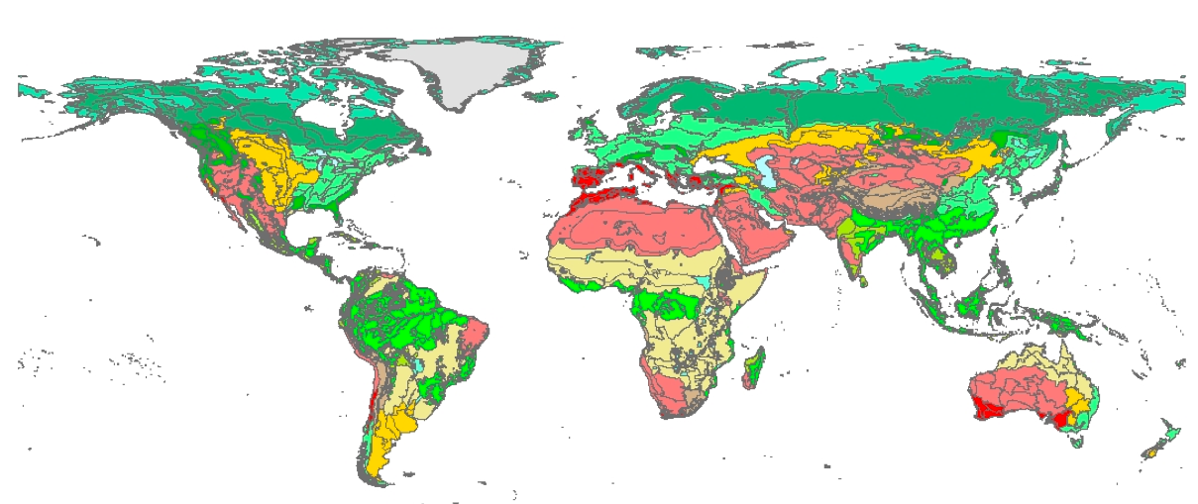
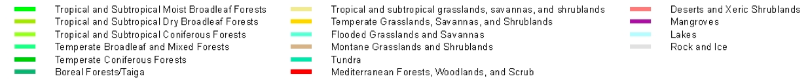
Regionalization on the level of biomes

Slide 78
Regionalization on the level of ecoregions

Slide 79
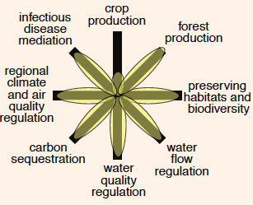
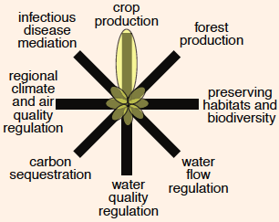
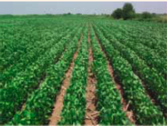
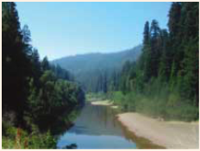
Land use impacts on ecosystem services
Foley, et al. (2005) Science 309, 570
Natural habitat
Intensive agriculture

Slide 80
Context and issues within LCA
A tool to support decision-making with assessment of the environmental impacts of a given product/service at each step of its life cycle
Relevance of land use impacts, contribution to damages on ecosystem quality
Actual methods for global scale are still lacking in LCA:
  Numerous approaches: lack of consensus
  No spatial differentiation
Avoid using alternative assessment methods
  Environmental Impact Assessment (EIA)
  Risk analysis
Reduces the credibility of LCA results
Notes:
80

Slide 81
Complexity of ‘’land use’’ impact category
Issues while quantifying
  No flow is emitted : not based on mass and energy balance
  Accounts for physical impacts (double counting with eco-toxicity and water use)
  Based on the development of the ecosystem quality
Main impacts on natural ecosystems
  Biodiversity (intrinsic value)
  Ecological soil quality: ecosystem services (functional value)
Notes:
81

Slide 82
Impact pathways
Life Cycle Inventory
Life Cycle Impact Assessment for Natural Environment
Effects
Midpoints
Endpoints
Populations/Habitats/
Landscapes
Biodiversity
Biodiversity Damage Potential (BDP)
Land use type
Biotic Production Potential (BPP)
Chemical and physical properties of soil
Area
Carbon Sequestration Potential (CSP)
Water quality
and quantity
Time
Ecosystem Services Damage Potential (ESDP)
Properties of below/above ground biomass
Fresh Water Regu-lation Potential (FWRP)
Location/
Topography
Microclimate
Erosion Regulation Potential (ERP)
Water Purification Potential (WPP)

Slide 83
Impact pathways for land use
Koellner et al., 2013
Koellner et al., 2013
Life Cycle Inventory
Life Cycle Impact Assessment for Natural Environment
Effects
Midpoints
Endpoints
Biodiversity
- de Baan et al., acc.
- de Souza, subm.
Populations/Habitats
Land use type
Biotic Production Potential (BPP)
- Brandão & Milà i Canals, acc.
Biodiversity Damage Potential (BDP)
Chemical and physical properties of soil
Area
- Baitz, 2002
- Beck et al. 2010
- Bos et al., under revision
Carbon Sequestration Potential (CSP)
- Müller-Wenk & Brandão, 2010
Time
Water quality
and quantity
Fresh Water Regu-lation Potential (FWRP)
Ecosystem Services Damage Potential (ESDP)
Location/
Topography
LANCA
Properties of below/above ground biomass
- Saad et al., 2011
- Saad et al., subm.
Erosion Regulation Potential (ERP)
Microclimate
Water Purification Potential (WPP)
83

Slide 84
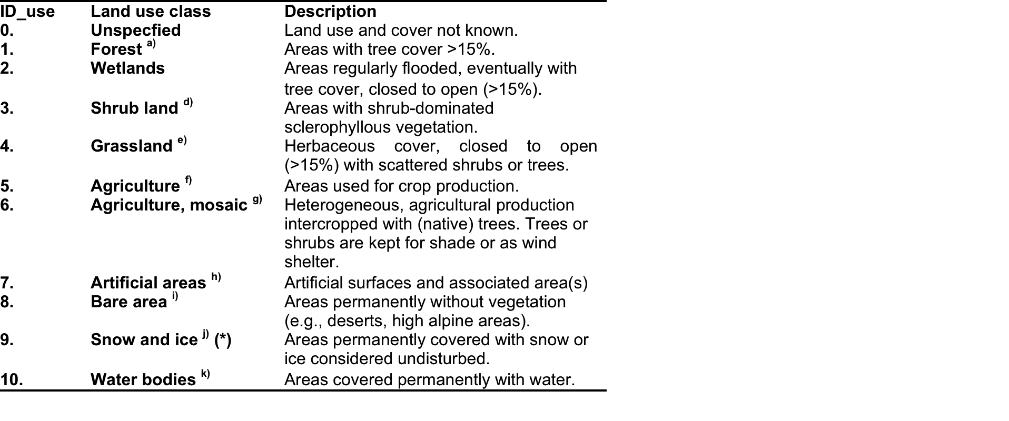
Land use classification (Level 1 based on GLC2000)

Slide 85
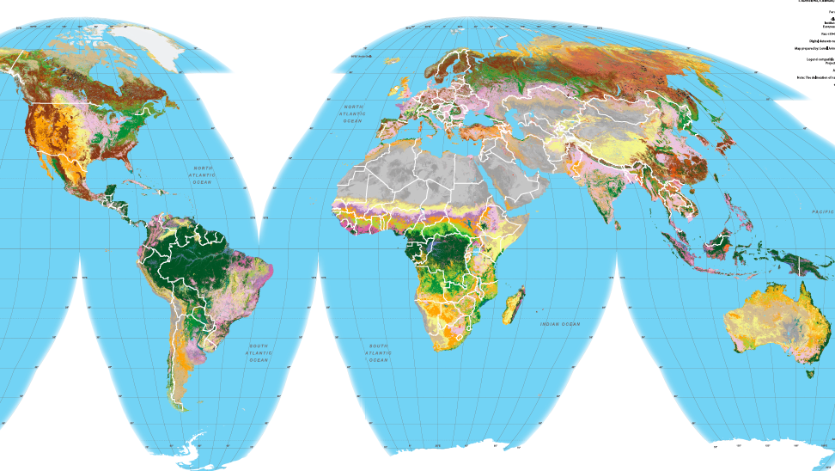
Global Land Cover GLC2000
Global Land Cover GLC2000

