Slide 1
Soil compaction – Sandra Eady
Soil compaction is the decrease in soil volume, in particular the air-filled fraction. It can be expressed by bulk density, pore volume, porosity, void ratio or soil strength.
Soil compaction alters soil structure, limits water and air infiltration and impedes root penetration. Hence, it is an important consideration for soil function and good plant growth.
Quantifying soil compaction would encompass gathering information on types and dates of field operations, machine mass and tyre width, the surface area affected and soil characteristics (water content, bulk density, soil texture, plastic limit of the soil, below cultivation depth, zero tillage, controlled traffic which purposely compacts, can increase n2O emissions, SOM not a good indicator, some get rid of livestock to get rid of compaction, industry specific like for cotton, horticulture row traffic.).
Source: Garrigues et al. 2013. Development of a soil compaction indicator in life cycle assessment. International J Life Cycle Assessment 18:1316.

Slide 2
Soil compaction – Sandra Eady
Quantifying soil compaction would encompass gathering information on types and dates of field operations, machine mass and tyre width, the surface area affected and soil characteristics (water content, bulk density, soil texture).
It is likely to need models of soil water and bulk density e.g. APSIM for soil water, COMPSOIL bulk density every 5 cm from 0 to 50 cm deep. Other models? International consistency?
It could be regionalised using GIS layers for key data.
Source: Garrigues et al. 2013. Development of a soil compaction indicator in life cycle assessment. International J Life Cycle Assessment 18:1316.

Slide 3
Soil erosion dynamics proxied by lateral cover
Dr. Adrian Chappell
Life Cycle Assessment workshop; April, 2014

Slide 4
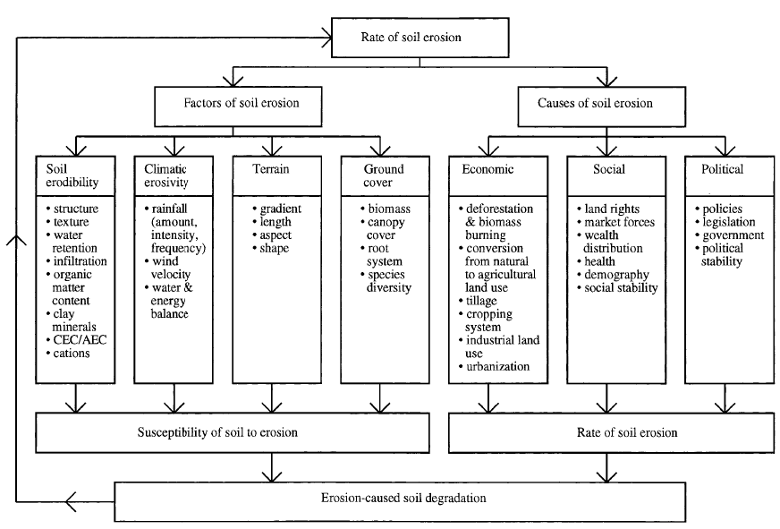
Soil erosion: factors, causes and interactions

Slide 5
Factors controlling soil erosion
Universal Soil Loss Equation (USLE)
  Plot and rainfall simulator experiments;
  Average annual soil loss (A) includes rainfall erosivity (R), soil erodibility (K), topographic (L and S) and cropping and management factors (C and P)
  A = RKLSCP
Focus on soil erodibility?
  Index based on soil particle size, OM content, soil structure and profile permeability (Wischmeier)
Interface between erosivity and erodibility?
  Aerodynamic / fluid roughness

Slide 6
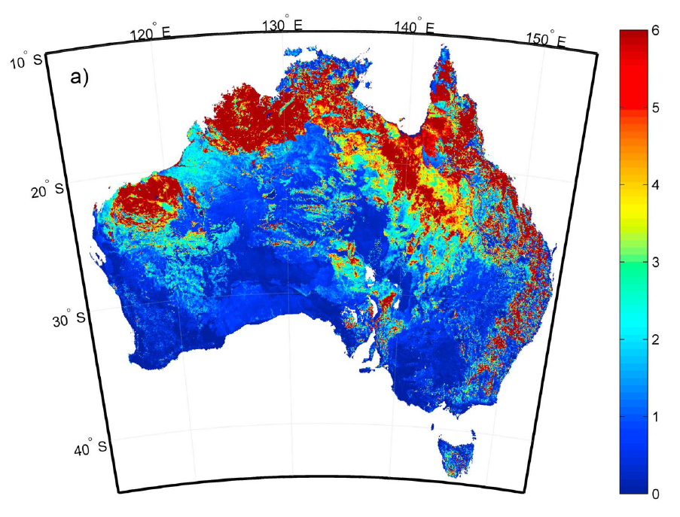
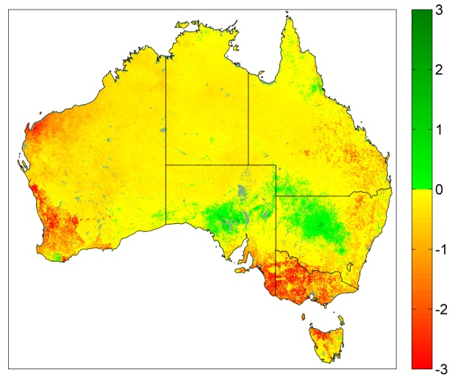
Australian soil erosion (t ha⁻¹ y⁻¹)
Gross (time period unspecified) hillslope water erosion (Lu et al. 2003 AJSR)
¹³⁷Cs-derived net (1950s-1990) soil redistribution (erosion and deposition) by all processes (wind, water and tillage; Chappell et al. 2011 JGR)

Slide 7
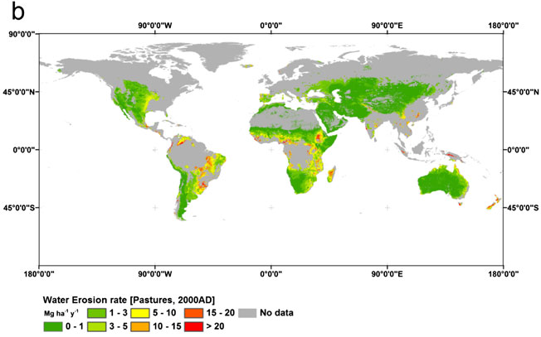
Global soil erosion estimates
Oceania gross water erosion (year 2000): cropped = 0.3 Pg y⁻¹, pasture = 0.5 Pg y⁻¹ (Doetterl et al., 2012)
Australian net (1950s-1990) soil redistribution (all processes): cropped = 0.079 Pg y⁻¹, rangeland = 0.15 Pg y⁻¹
  Gross water erosion larger - but pasture / rangeland dominated by wind erosion - similar for wrong reason?

Slide 8
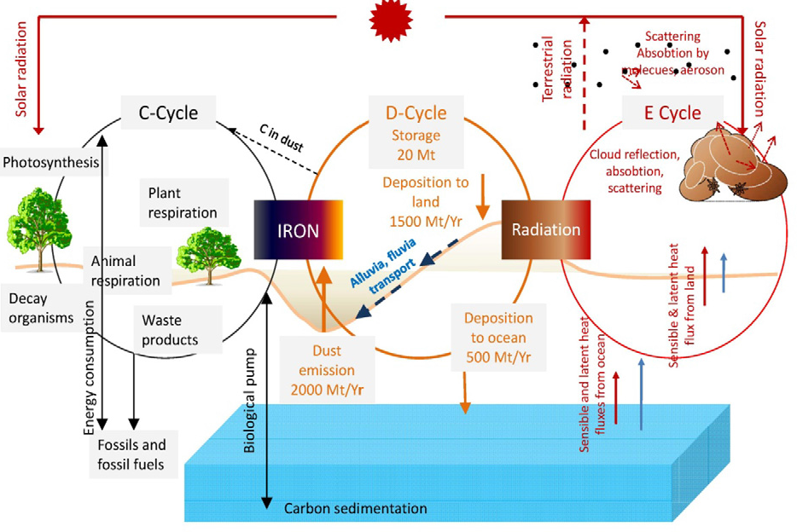
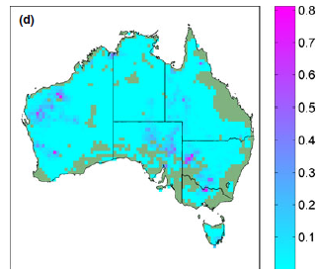
…and wind erosion (dust emission)
Efficient, selective and rapid ‘conveyor’ from terrestrial ecosystem of flows.
Dust cycle interrelated with C and energy cycle
Australian dust emission (2000-2010)
  Cropland - larger rate, small area, small total 0.004 Pg y⁻¹
  Rangeland – smaller rate, large areas, large total 0.1 Pg y⁻¹
Rangeland gross water erosion unreliable?

Slide 9
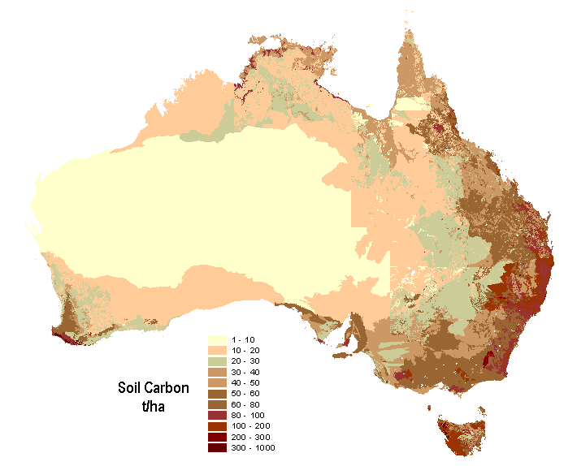
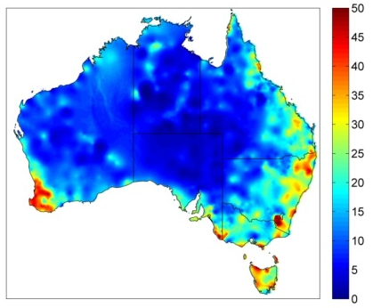

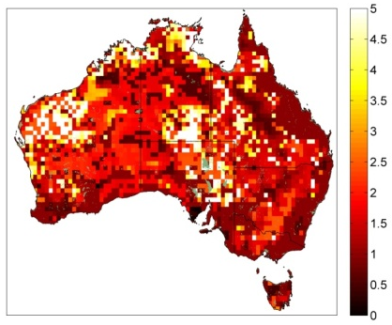
Conveyor (C, N, P…) dynamics
Native or recent?
Enrichment:
Property dependent
Typically approx
(tC ha⁻¹ y⁻¹)
Erosion rate dynamics:
Pre-European,
Ag expansion,
Ag stabilisation?

Slide 10
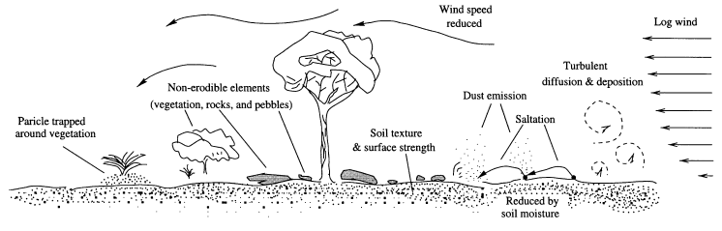
Soil erodibility
Soil erosion difficult (expensive) to measure repeatedly over large areas (monitor) – proxy?
Erodibility - dominated by (aerodynamic / fluid) surface roughness (approximated as lateral cover)

Slide 11
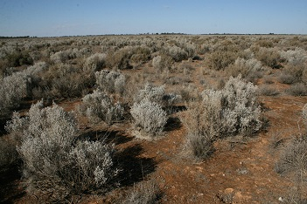
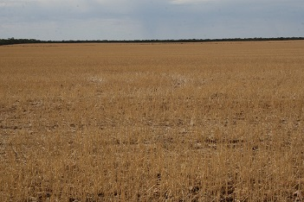

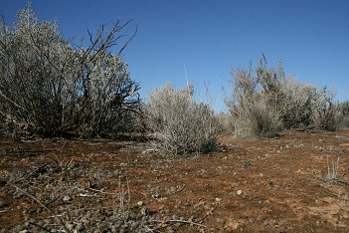
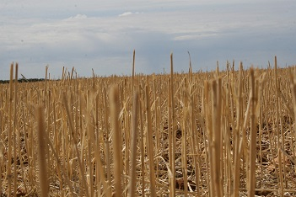
Lateral cover (λ)
λ=n b h / s
width
=
height
wind
wake

Slide 12
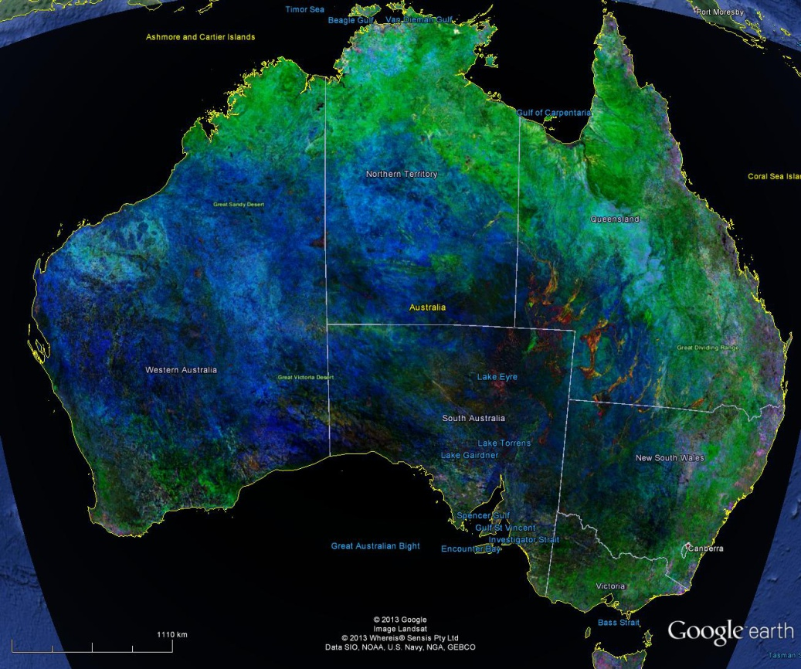
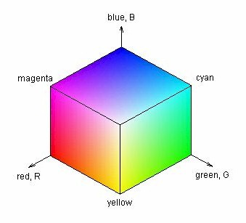
Australian lateral cover (March 2013)
MODIS RGB
  R=λ_{SWIR3} (brown veg)
  G= λ_{NIR} (green veg)
  B=λ_{BLUE} (bare)
Every 500 m and 16 days
Using MODIS (albedo) MCD43A3

Slide 13

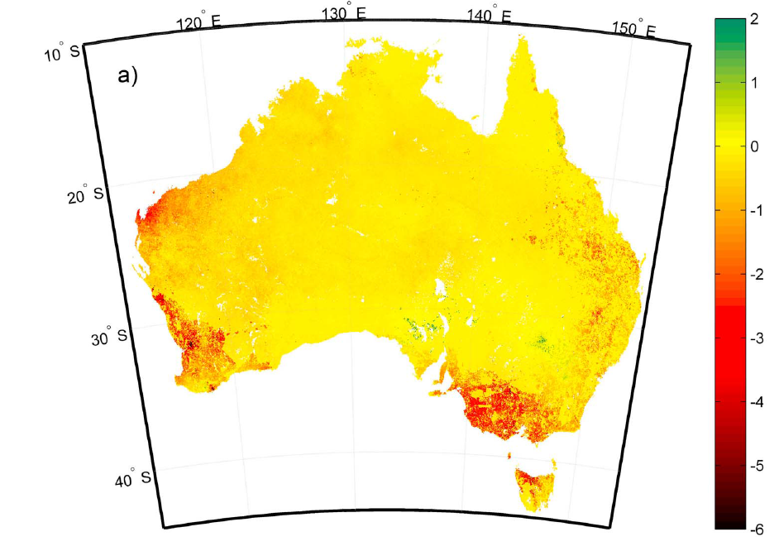
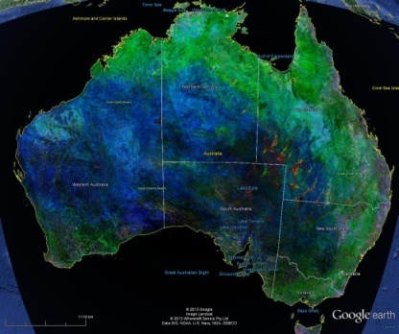
Soil condition (quality indicator) ≈ lateral cover
Modelling of soil erosion using USLE:
  Available data layers (local-regional)
  Water erosion only and uncertain
  WEQ (never been applied globally)
Mapped ¹³⁷Cs-derived net soil redistribution provide baseline 1990
  Measure ¹³⁷Cs in SCaRP samples to map difference 2010 (cultivated land only)?
Replace with lateral cover controlling soil erosion?
  Clearing, grazing and cultivation can be represented as change in aerodynamic roughness across scales of veg (green), residues (brown) and soil (bare)

Slide 14
Thoughts arising from discussion…
Uniqueness
  Misleading (second-order) focus on Australian soil
  Replace with commonality to maximise applicability
First order
  Land use change and management fundamentally changed soil condition from native to current
  Second-order indicators cannot explain this fundamental change in soil condition
  Indicator(s) which explain the first order changes to Australian soil condition are globally significant = soil erosion (lateral cover).
Dynamics
  Which erosion rate used in LCA calculation, pre-European settlement, ag expansion, ag stabilisation?
Conveyor
  Requirement to quantify loss of e.g., soil nutrients or to more generally indicate change?

Slide 15

Soil contaminants and LCA – Rai Kookana
What are they?
How do they get there?
How do they affect soil function?
Measure/ Estimate for regional scale
Salts, heavy metals, metalloids, pesticides, biocides, PAHs, pharmaceuticals, etc.
Irrigation, fertilisers, pesticides, manures, wastewater, biosolids, air, geogenic
Productivity, soil fertility, quality of produce, microbial activity, C & N cycling; ecosystem services
Depends on type, Indicators; Surrogates; Not really sure....

Slide 16
Soil contaminants – measures /estimates
Pesticides and Fertiliser
Veterinary drugs
Heavy metals/metalloids
Acid sulphate soils
Soil organic matter (non-ionic pesticides)
Soil pH, clay + SOM (ionisable)
Rate and frequency of application
Ionisable – acidic/basic drugs
Soil pH, clay content, SOM
Rate and application of administration
Soil pH, mineralogy (iron oxides)
Do we know where these hot spots are?
Geology/Mineralogy, redox status, Soil pH
Are these mapped?

Slide 17
Soil Organic Matter
Ryan Farquharson – CSIRO

Slide 18
Soil function – what’s the end game?
Support plant growth – think like a plant
  Nutrient ‘bank’
  Water storage
  Structure
Store more (or lose less) soil carbon – think like a carbon containing molecule
  Protection from agents of decomposition
    Biological; Physical; Chemical
Others?
  Water quality….

Slide 19
Soil Organic Matter
Once living material in the soil at various states of decay
Composed of carbon, nitrogen, sulfur, phosphorus….
Different components have different:
  chemical composition
  stability/residence times
  functions in the soil
Beware perverse outcomes
  N₂O, CH₄

Slide 20
Functions of organic matter in soil
Biological
  Energy source for microbes
  Nutrient source microbes
  Habitat
Physical functions
  Structural stability
  Water dynamics – water retention and infiltration
  Thermal properties
Chemical functions
  Cation exchange capacity
  pH buffering
  Complexation of cations
NOTE: functionality is soil type specific, and different components of SOM have different functionality.

Slide 21
Quantification of SOM
TC, TOC, Fractions
Physical fractionation, IR-PLS estimates
Spatial modelling
Isotopic techniques
Quantification of SOM function
Not well developed
  Use of OC in pedotransfer functions for water holding capacity
  Elemental stoichiometry and nutrient (N) availability
More work needed…

Slide 22
Modelling SOC
Ryan Farquharson - CSIRO

Slide 23
Soil Organic Matter Recap
SOM composed of a range of materials
Components have different residence times (hours to millenia) and functions:
  Biological (energy and nutrient source)
  Physical (structure, water, thermal)
  Chemical (pH buffering, cation exchange)
Function is soil type dependent
Qunatification of SOM:
  TOC, fractionation, IR estimates, isotopes, spatial modelling
Quantification of SOM function:
  Water holding, nutrient availability
  Needs more work

Slide 24
Compartment models
Process based (inputs and losses) for a point in space
Division of OM into compartments
  Each compartment or ‘pool’ has an inherent decay rate modified by water and temperature
Assumptions made on microbial efficiency, stoichiometry, protection mechanisms
Plant production, soil parameters, climate data
Measured fractions vs conceptual pools
  Initialisation
No functional feedbacks
  e.g. SOM on water holding capacity and hence productivity

Slide 25
Modelling soil organic carbon – RothC model
RothC Model
DPM
Plant
Inputs
CO₂
Decomposition
RPM
BIO
Decomposition
CO₂
HUM
BIO
Decomposition
Fire
IOM
HUM
Modelled pool | Measured fraction
Resistant (RPM) | Particulate (POC)
Inert (IOM) | Recalcitrant (ROC)
Humus (HUM) | Humic (HOC)

Slide 26
Calibration of RothC to Australian conditions
Clearing of Brigalow bushland
Measured fractions
Measured fractions
70
70
TOC
TOC
TOC
TOC
POC
POC
POC
60
POC
60
HUM
HUM
HUM
HUM
50
50
CHAR
CHAR
CHAR
CHAR
C (t/ha)
C (t/ha)
40
40
Modelled fractions
30
Modelled fractions
30
TOC
TOC
TOC
20
TOC
20
RPM
RPM
RPM
RPM
10
10
HUM
HUM
HUM
HUM
0
0
IOM
IOM
IOM
IOM
1982
1982
1987
1987
1992
1992
1997
1997
Year
Year

Slide 27
SOC modelling for Australian Wool Innovation
RothC model runs
  50 year climate data and plant residue inputs (GrassGro predictions for two paddocks)
  Variable initial SOC pools
    sampled from probability distributions of SCaRP SOC fractions
  Variable clay content
    sampled from probability distributions of clay content from ASRIS
  Correlations

Slide 29
Where has the carbon gone?
GrassGro derived plant residue inputs optimistic
Residue losses prior to entering soil unaccounted
Default decay constants too slow
Microbial efficiencies too high
Erosion losses unaccounted for
There is potential to increase SOC

Slide 30
Modelling Soil carbon change
Jeff Baldock - CSIRO

Slide 31
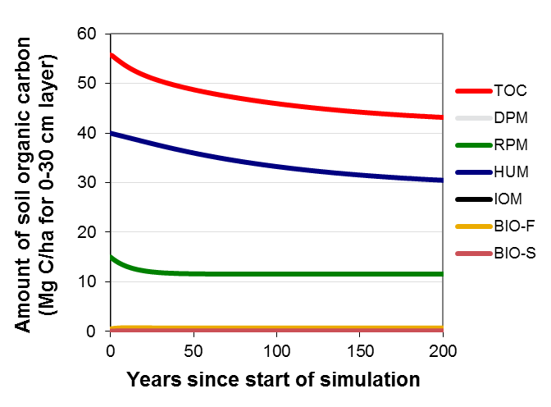
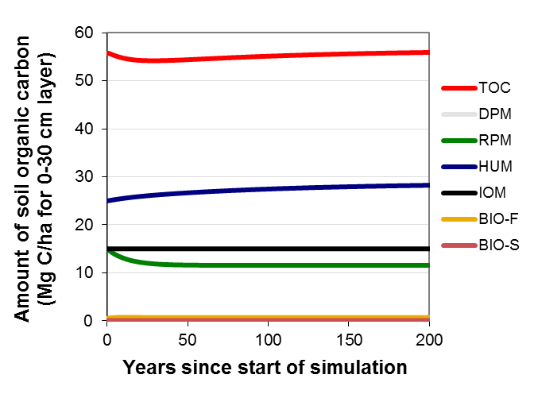
Modelling soil carbon change – important principles:
SOC composition and model initialisation
RothC Model
DPM
CO₂
C_{t} = C₀ e^{-abckt} + A
Plant
Inputs
RPM
BIO
CO₂
C_{loss} = C₀ (1 - e^{-abckt})
IOM
HUM
BIO
Fire
HUM
Model initialisation
organic carbon has to be partitioned into components
Partitioning will alter the rate SOC stock change

Slide 32
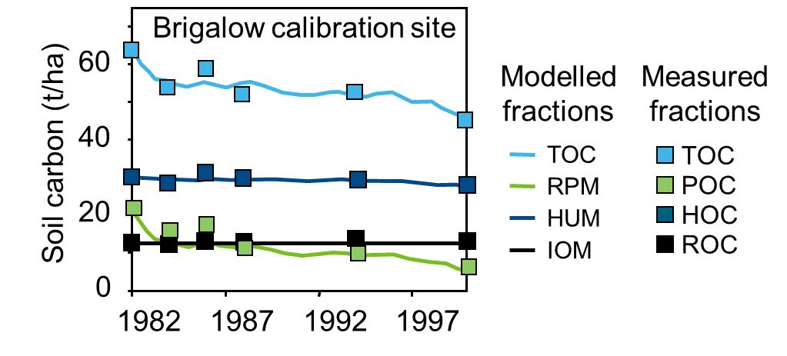
Modelling soil carbon change – important principles to consider: tuning models to measureable fractions
Particulate carbon
(2mm – 0.05 mm)
Humus carbon
(<0.05mm)
Resistant
(charcoal <2mm)
Replace conceptual model pools with measurable fractions
RPM = POC
HUM = HOC
IOM = ROC (Charcoal C)

Slide 33
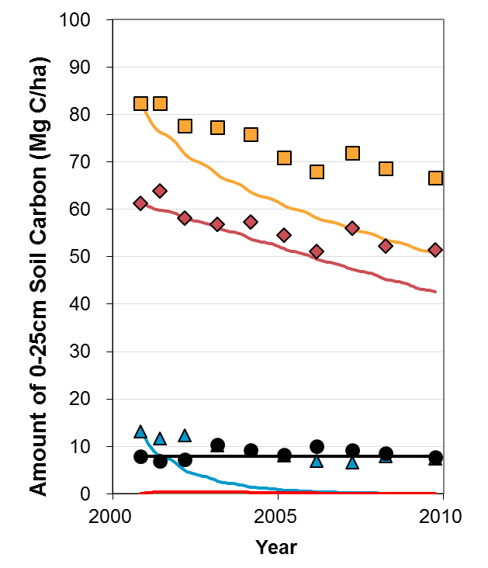
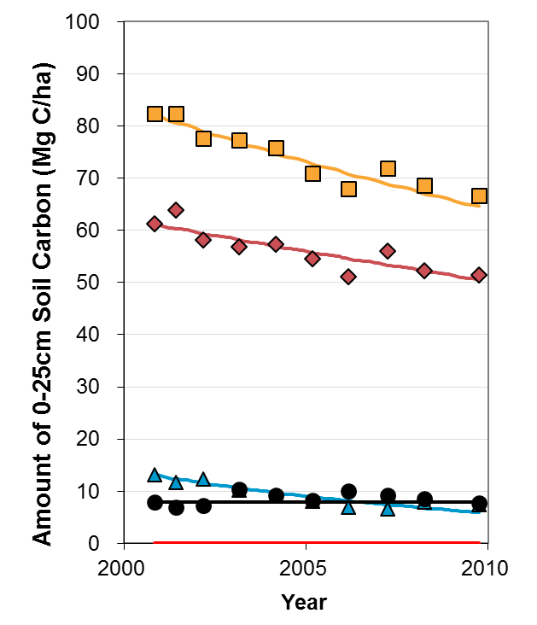
Modelling soil carbon change – important principles: calibration of rate constants
No site specific calibration of k values
After site specific calibration
of k values
k_{HOC} = 0.040 y⁻¹
k_{POC} = 0.509 y⁻¹
k_{HOC} = 0.021 y⁻¹
k_{POC} = 0.072 y⁻¹

Slide 34
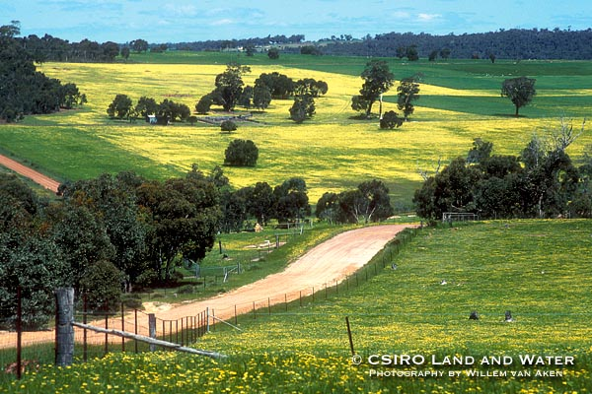
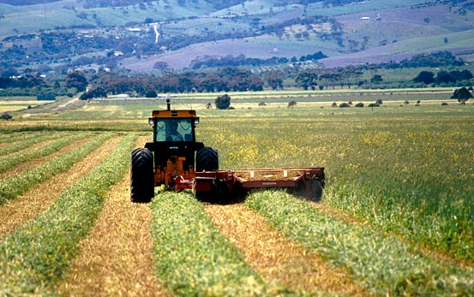


Modelling Farming Systems Productivity and Environmental Performance - SOC example
Enli Wang, Zhongkui Luo, Jeff Baldock, Hongtao Xing, Peter Thorburn
30 May 2013, Melbourne
CSIRO Sustainable agriculture Flagship / CSIRO Land and water

Slide 35
TOOL: APSIM- Agricultural Production Systems Simulator
System Control
Manager
Clock
Report
Canopy
Met
Crops
Wheat
ENGINE
SoilWat
SWIM
Maize
SoilN
Sorghum
SoilPH
Soil
Legume
SoilP
Other Crops
New Module
Irrigate
Erosion
Fertiliser
Other module
Economics
SurfaceOM

Slide 36
INPUT DATA & systems approach
RESOURCES/INPUTS
KNOWLEDGE INTEGRATION
PERFORMANCE EVALUATION
1. Climate
(Rn, T, P, E)
2. Soils
(PAWC, SOC, pH)
1. Productivity
(NPP, Grain yield, Sugar, Oil)
2. Economics
(Costs, Benefits, $ return)
3. Environment
(SOC, CO2, N2O, NOx, NH3, Leach, Drain, Salt)
Agricultural
Systems
Model (APSIM)
3. Plant/Crops
(Rotation type)
4. Management
(N, Irrig, tillage)

Slide 37
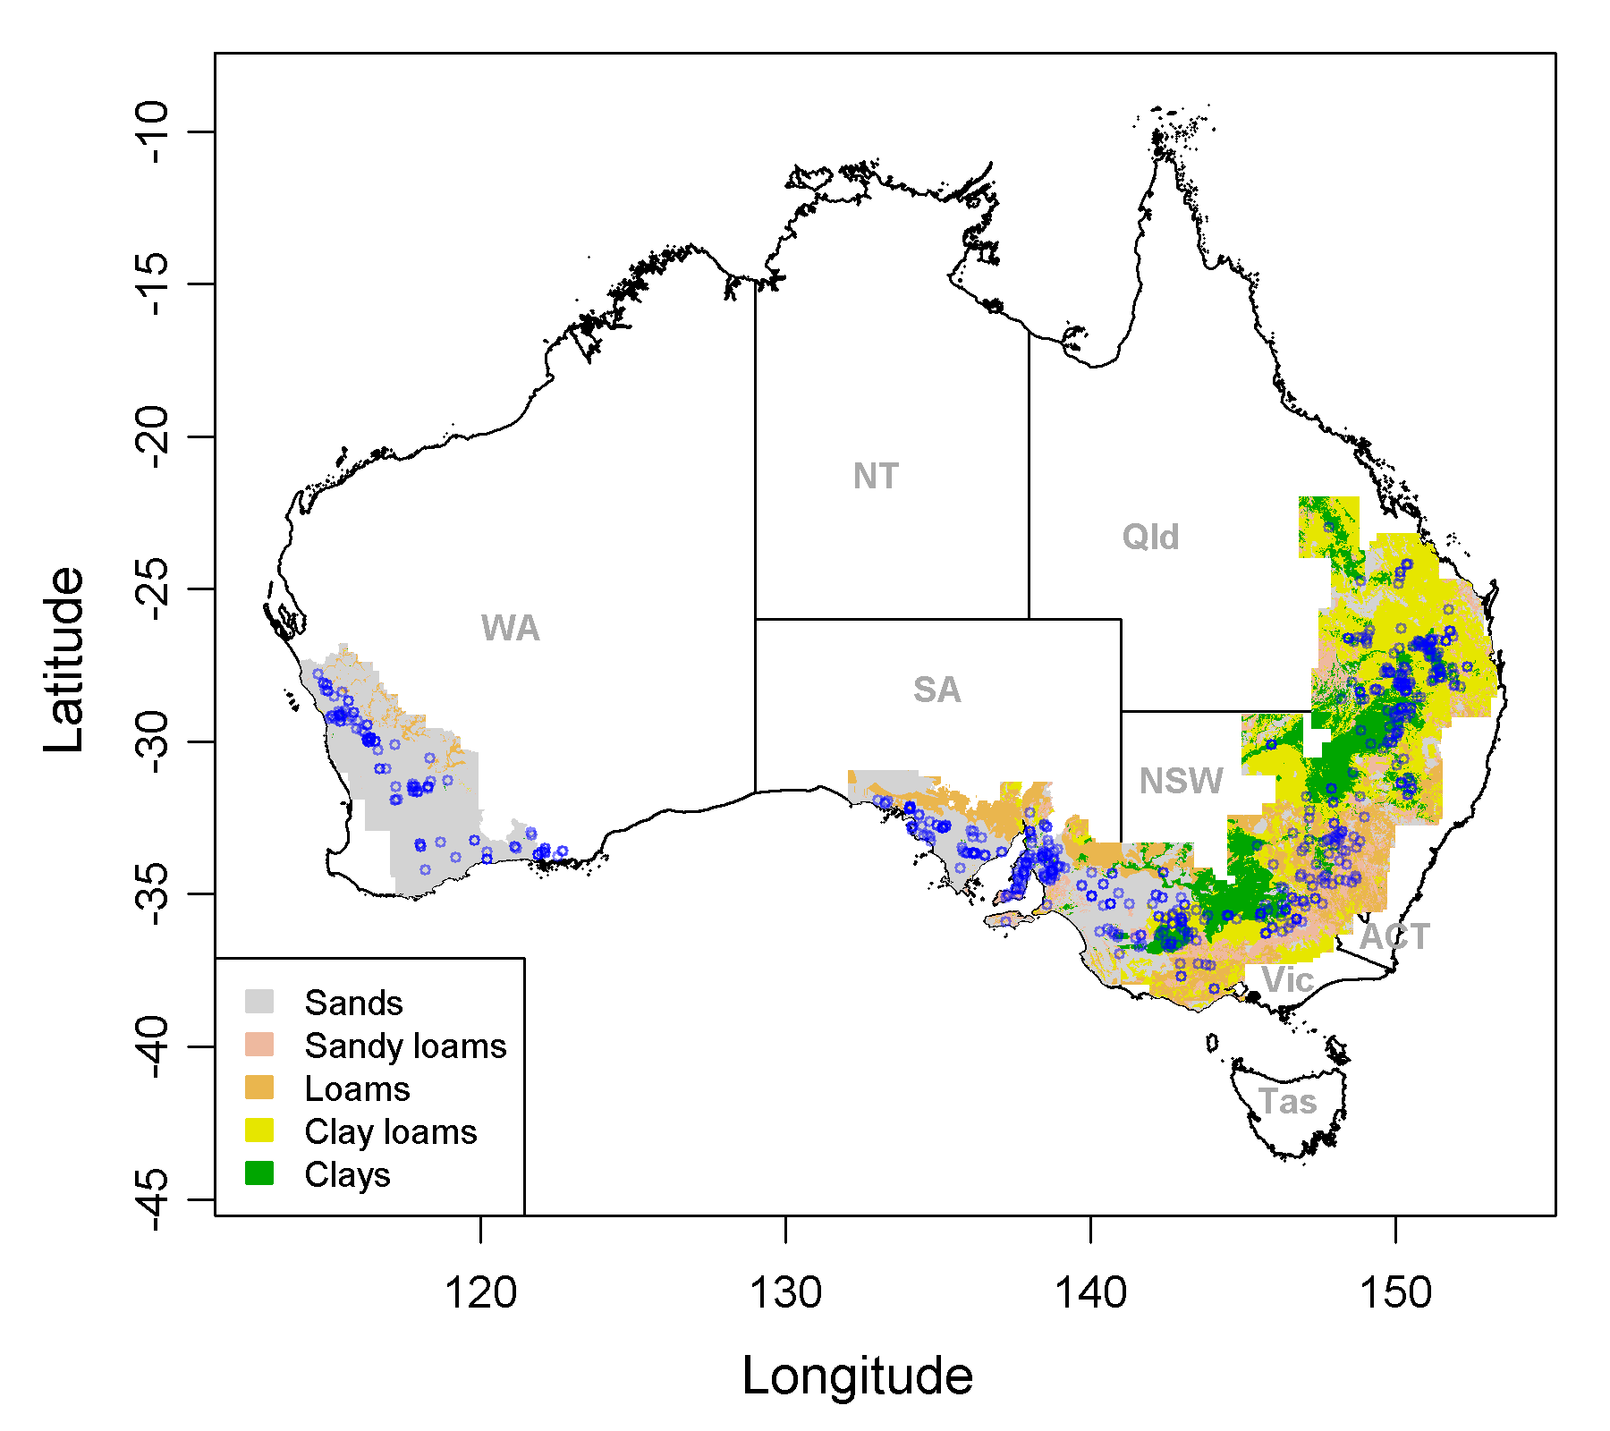
SOIL DATA – APSRU soil profiles + soil classes
Black circles show locations of the 613 APSRU reference sites
Point simulations at 613 sites
Point + class data to derive distribution of soil properties
Metal model to link SOC to driving variables
Grid prediction using metal model and derived soil properties

Slide 38
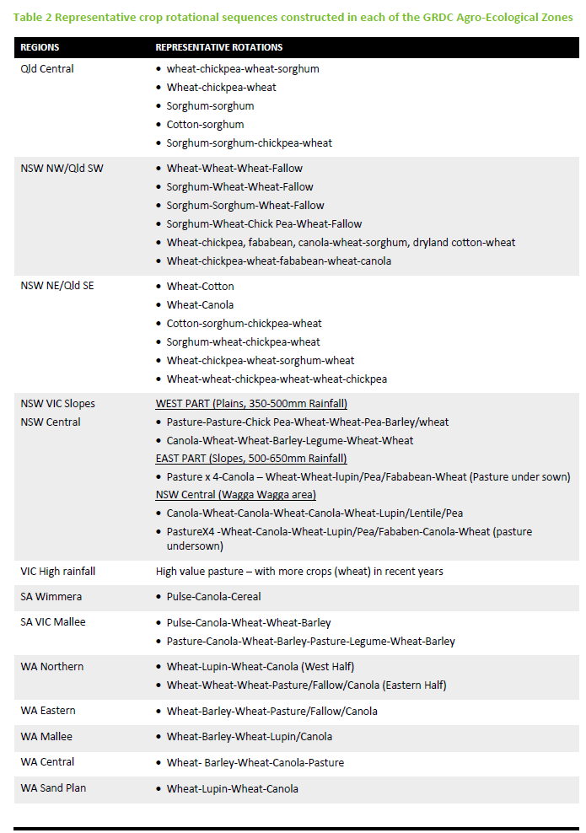
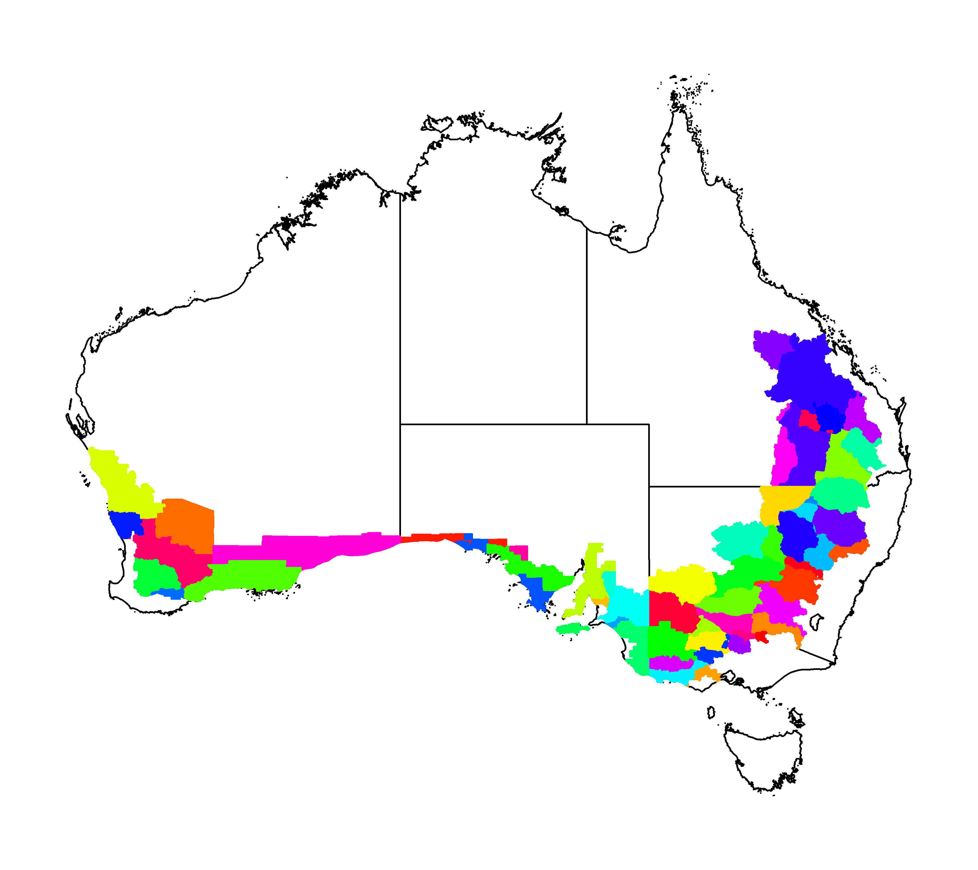
Representative rotations
Sub-Regions for refined representative crop rotations & management scenarios

Slide 39
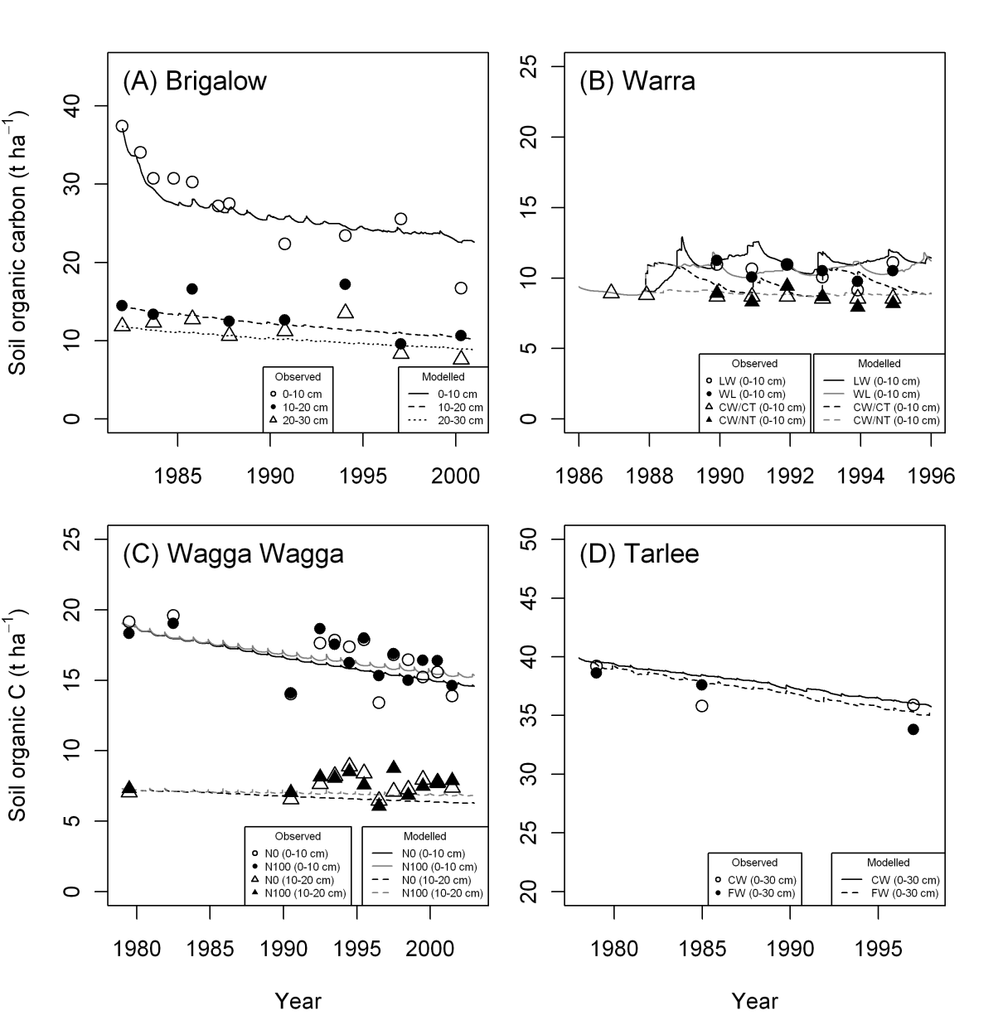
Maturity of technique:
Model performance
Biomass and grain yield
Soil organic carbon

Slide 40
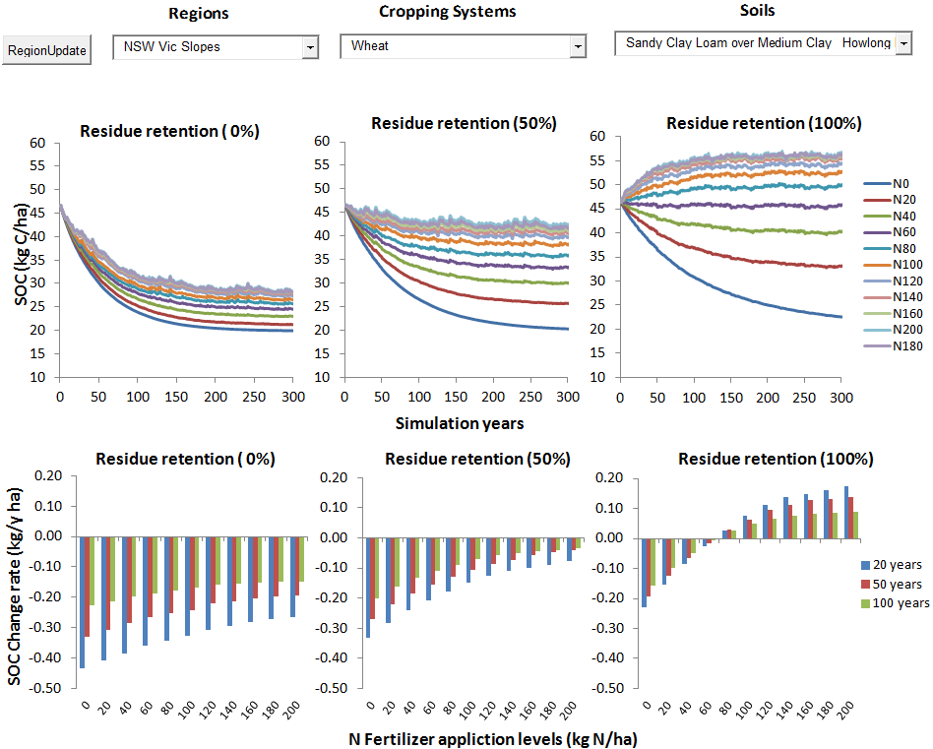
Point Simulations (Scalability):
SOC Potential – Crop, Residue, N application

Slide 41
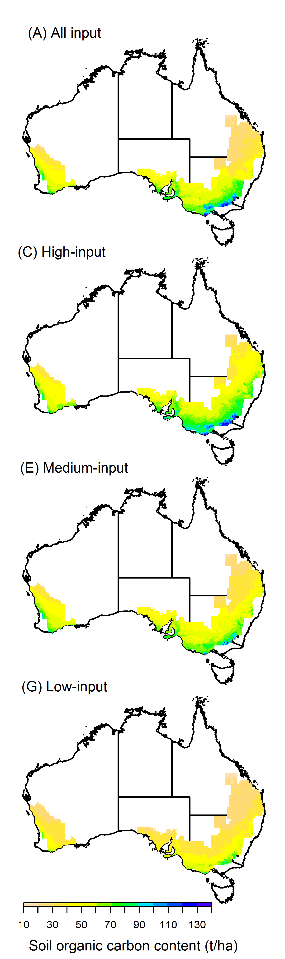
Scalability:
SOC Potential – regional scale
Representative rotations

Slide 42
Thank you
CSIRO Land and Water
  Dr Enli Wang
  Principal Research Scientist
    t +61 2 6246 5964
    e Enli.Wang@csiro.au
    w www.csiro.au
Csiro land and water / sustainable agriculture flagship

Slide 43
Possible sources of Soil quality indicators in LCA
Keryn Paul - CSIRO
Need a whole-farm/landscape approach to soil quality indicators
Impact of not only efficient rotations/crop management, but also woody veg. (paddock trees, riparian plantings, belts etc.)
Some examples...
Soil carbon: FullCAM-RothC
  calibrated to 2 plantations, and currently work underway to calibrate it to ~120 environmental plantings in farmlands across Australia.
Eutrophication: SNAP model for predictions of avail N under woody veg.
  calibrated and validated against 17 studies (61 treatments) in southern Aust.
Water availability/dryland salinity
  3-PG calibrated and validated against 100’s of different types of plantations and environmental plantings across southern Australia

Slide 44
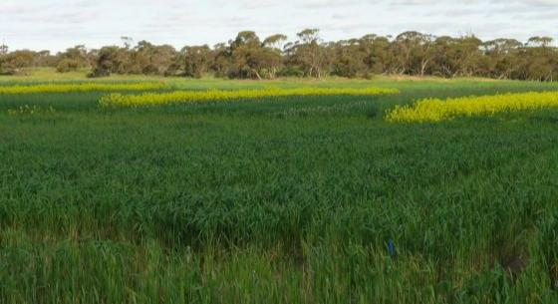
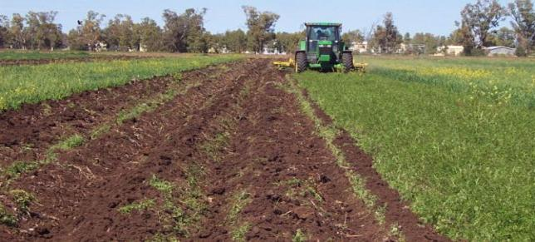
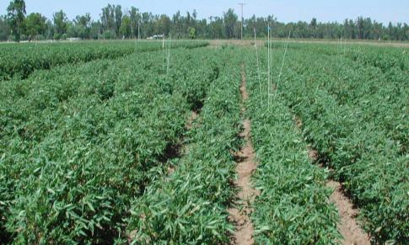

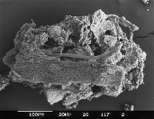


Functional (microbial) ecology in terrestrial environments
Below ground diversity/function for impacts Aboveground
Gupta Vadakattu
  Biota in soil are diverse in terms of size, numbers and habitat requirement
  High phenotypic/taxonomic diversity and functional redundancy contribute to functional capability and resilience
  Habitat heterogeneity and microscale protection influences biota exposure to stress/stimuli and the response
    Key factors – availability of C, moisture, temperature, pH, chemical constraints
GHG
C
  Environment
  Management
Gupta V.V.S.R. (CES/SAF)
Notes:
Microbial ecology – interrelationships between MO and their living and non-living environmental components and it encompasses diversity, growth, activity and function in spatial context. Since populations in natural environments rarely exist independently complicated feedbacks exist between microbial populations and their biotic and abiotic environments within the ecosystem.
New developments in molecular techniques - enable us to quantify changes in microbial populations both in terms of genetic and functional diversity and determine the level of biological functions in cropping systems

Slide 45
Generating inventories for soil biota – Andrew Bissett
Standardised collection procedures (e.g., as in current soil microbiome projects (BASE, EMP, TERRAGENOME))
Sequence (amplicons or amplification free)
Sequence data is USELESS without associated contextual data (edaphic and non-edaphic sample properties)

Slide 46
Soil Acidification
Mike Webb - CSIRO

Slide 47
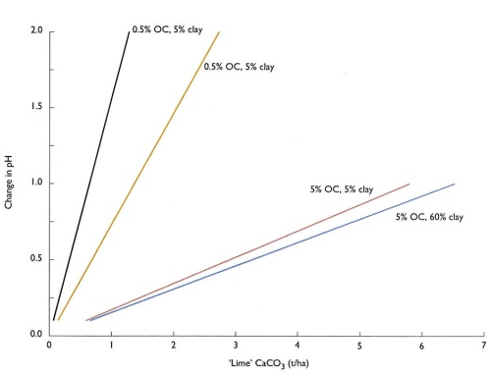
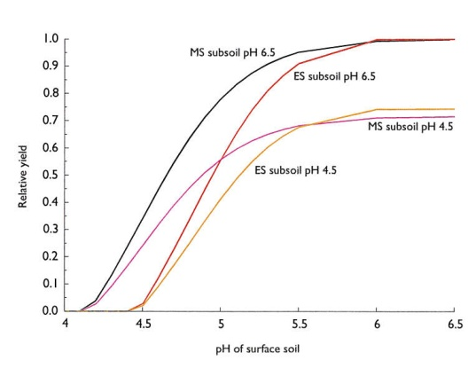
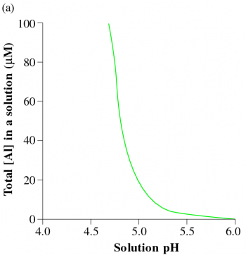
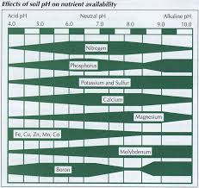
Soil Acidification
(agriculture induced, not acid sulphate soils)
What is it?
  the process by which the soil becomes more acid because of agricultural production
  pH 5.5, 4.8, 4.3 key trigger points
What does it do?
  lowers CEC, nutrient uptake, increases toxic elements Al and Mn
  permanent loss of clay minerals by dissolution (pH 4.3)
  reduces productivity (pH 5.5; pH 4.8)
What controls rates of acidification?
  the amount of acid that is added (NAAR)
  the ability of the soil to resist pH change (pHBC)
NAAR
  nitrogen fertiliser, lime
  product export
pHBC
  clay
  OM
Time to critical pH

Slide 48
Soil Acidification
(How to monitor or measure)
pH
  direct measurement
  surrogate eg MIR
pHBC
  based on clay, OM, (silt)
  already modelled, could do more
What controls rates of acidification?
  the amount of acid that is added (NAAR)
  the ability of the soil to resist pH change (pHBC)
NAAR
  nitrogen fertiliser, lime
  product export
pHBC
  clay
  OM
Time to critical pH

Slide 49
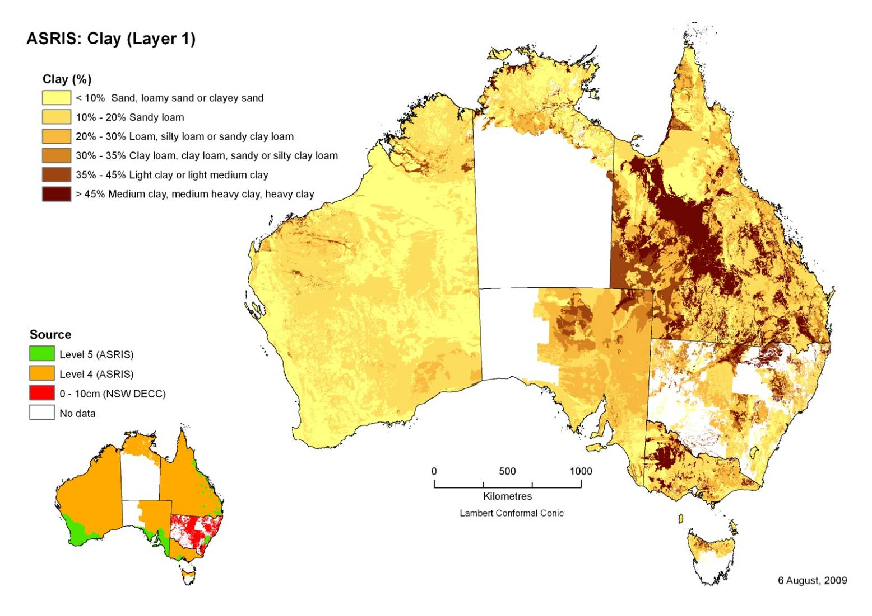
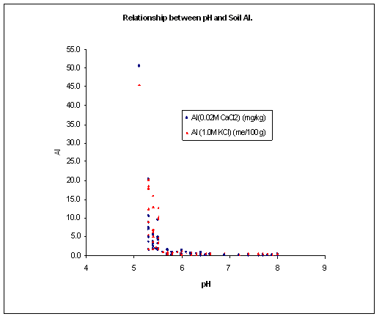

Slide 50
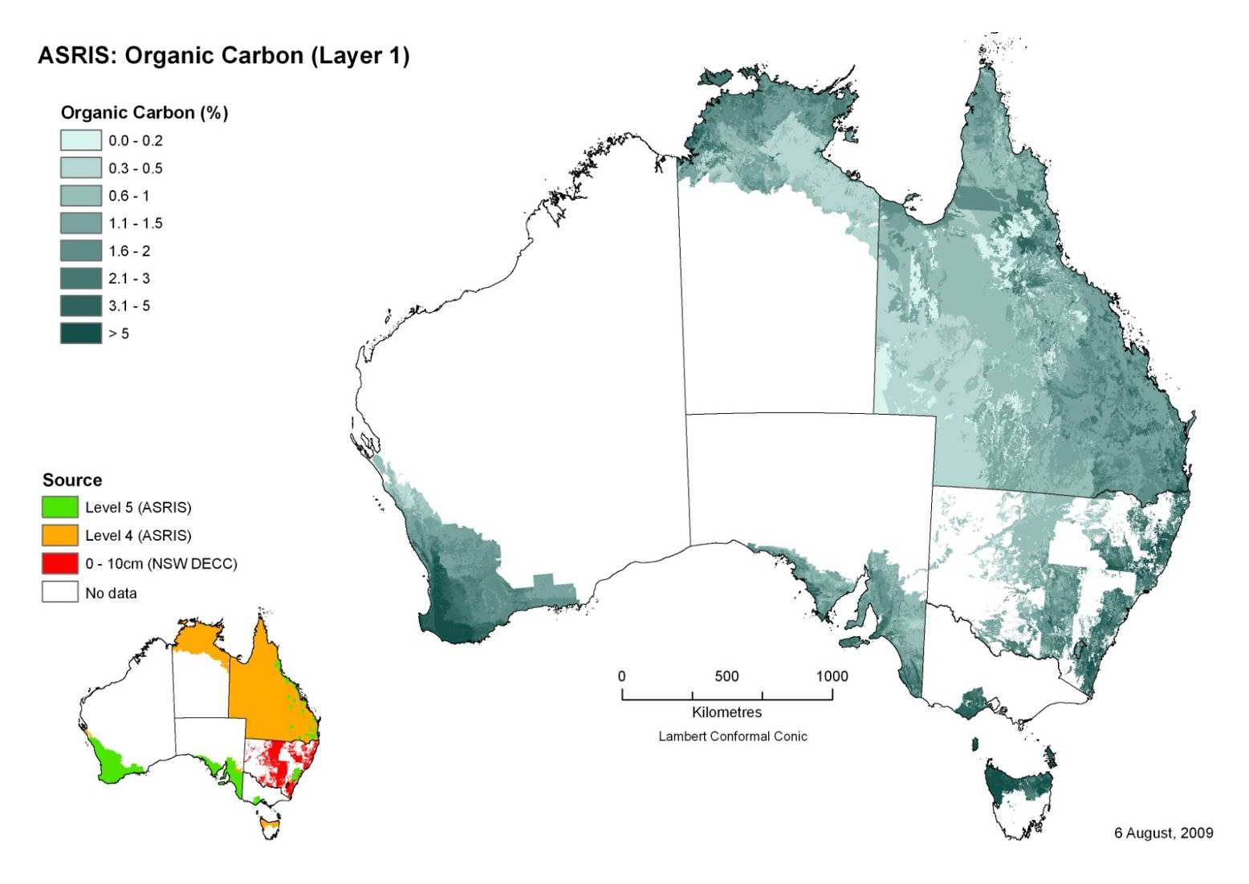

Slide 51
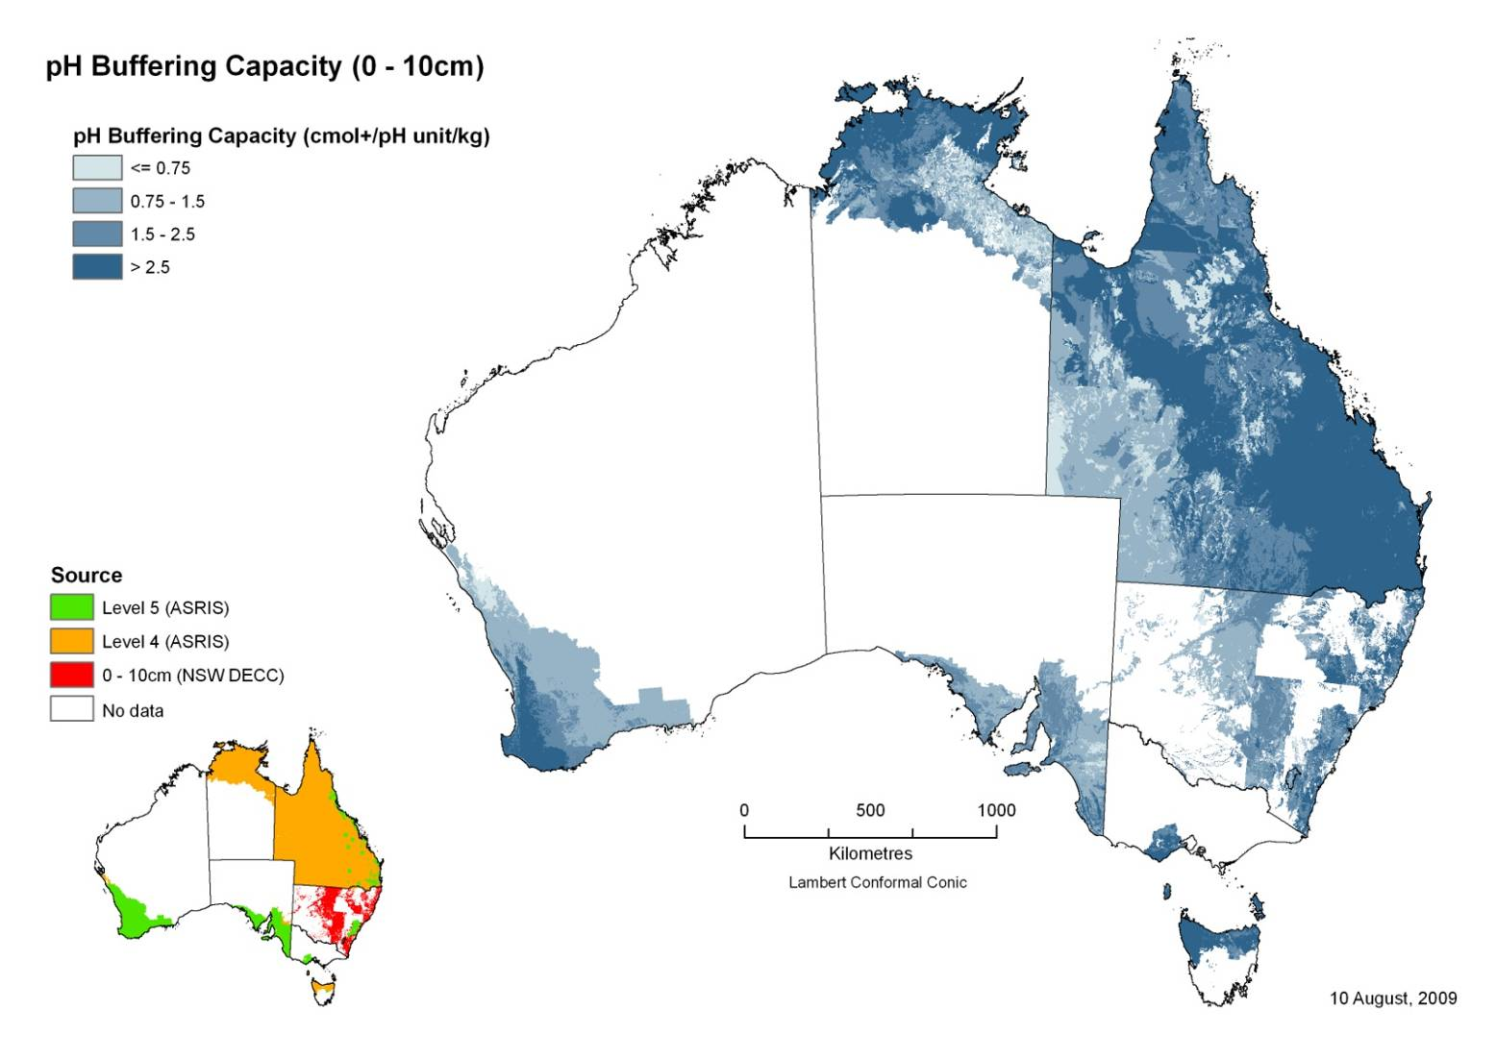

Slide 52
Soil Acidification
(How to monitor or measure)
NAAR
  Based on Statistical Local areas (SLA), which are based on population; some as small as 21 sq km .
  (usually urban) to 470,000 sq km

Slide 53
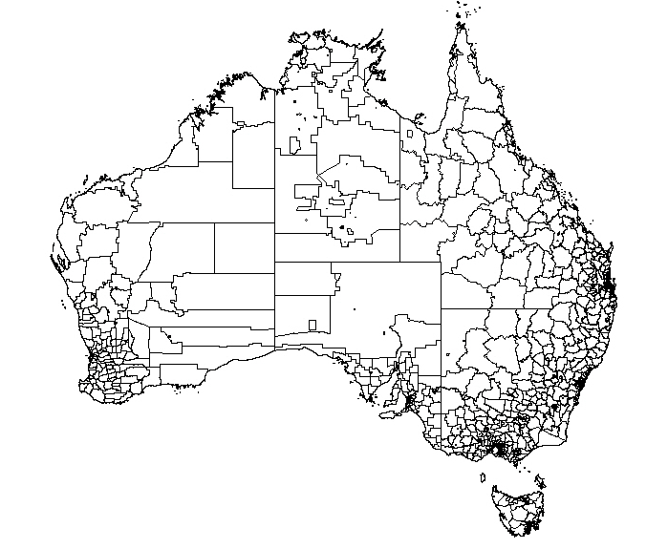

Slide 54
Soil Acidification
(How to monitor or measure)
NAAR
  Based on Statistical Local areas (SLA), which are based on population; some as small as 21 sq km .
  (usually urban) to 470,000 sq km
  NAAR = (product exported * ash alkalinity)
  + (FertiliserN x FertiliserFactor)
  Product exported (yield/ha) was calculated from rainfall (irrigation) and some crop efficiency factors (Unkovich et al; various publications)
  Ash alkalinity from literature Fertiliser factor is the efficiency of nitrate use (Adams 1984)
  Product exported is the sum of the different crops or pastures based on SLA data and weighted for the relative area of each crop or pasture.
  Thus the scale is that of the SLA,
  Nitrogen fertiliser use was calculated from yield of each crop or pasture and the protein content multiplied by an efficiency of uptake factor.

Slide 55
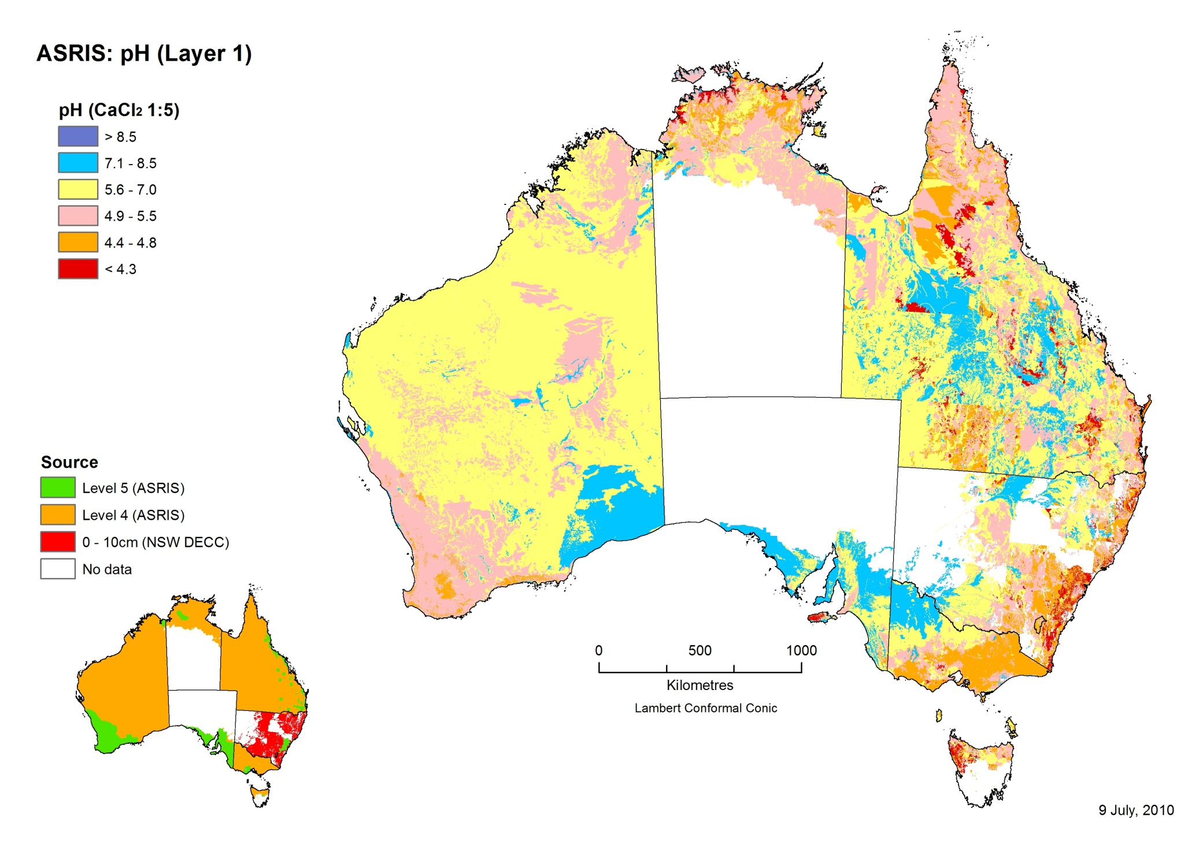

Slide 56
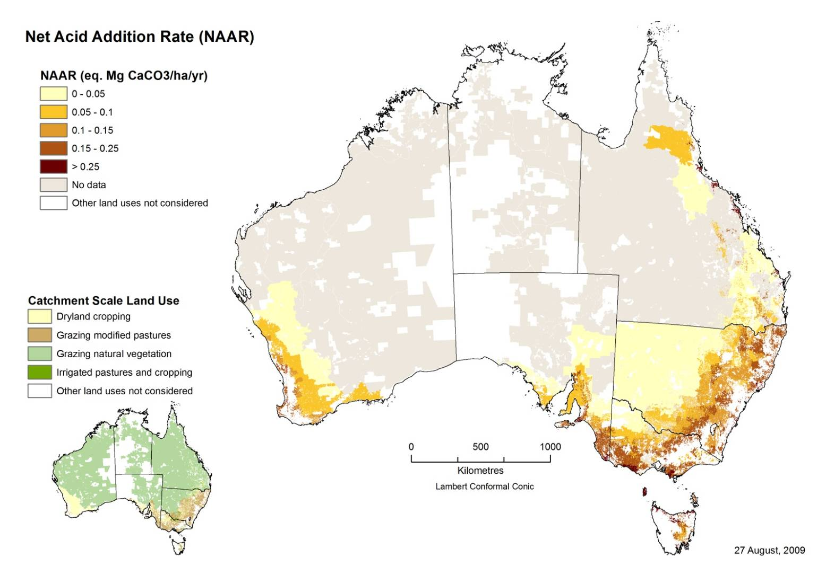

Slide 57
Time to critical pH
AR = (pHBC x 5 x Tc x BD) x (Curr pH – Crit pH)
x (1- CF/100)
Time (yrs) = AR / NAAR*PNAAR/100

Slide 58
